Slide 1
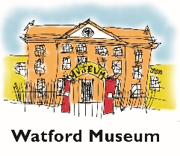
The Industrial revolution in Watford
About two Miles farther west lies Watford …... The Town is very long, having but one Street, which is the public, and so is extremely dirty in Winter Daniel Defoe wrote this in a book first printed 1724 and 1727, but revised and reprinted many times.
This map is from 1766

Slide 2
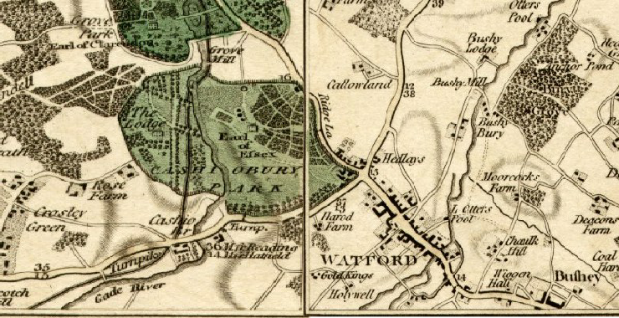
Before the railways came Watford was pretty much along one straight road with the short alleys, courts and yards coming off of it.
The fields were tied to the various farms, next to the boundary lines of the properties on the High Street; the farms were dotted around. This map is from 1800

Slide 3
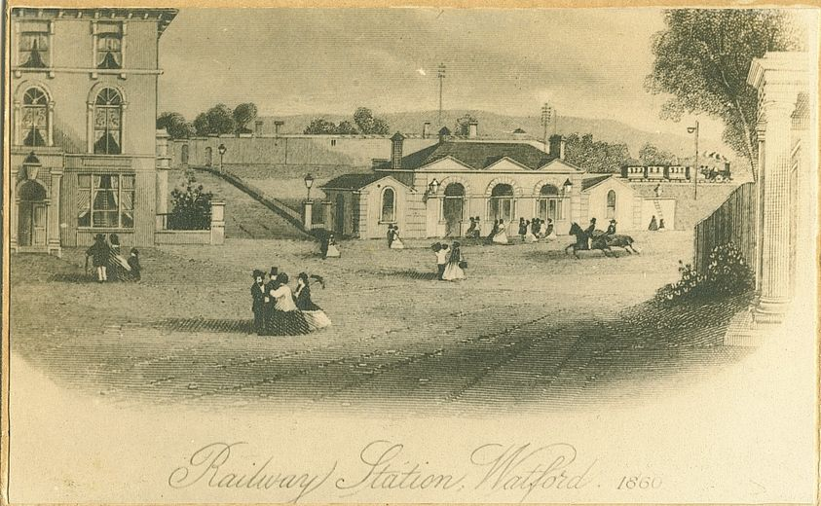
Part of the London and Birmingham Railway opened on 20 July 1837 and ran between Euston and Boxmoor.
In 1837 the town’s first railway station was opened near to the bridge in St. Albans Road. The station had first- and second-class waiting rooms, departure yard, carriage shed, engine house and facilities for pumping water. In 1843 even Queen Victoria and Prince Albert took the train from Watford Station.

Slide 4
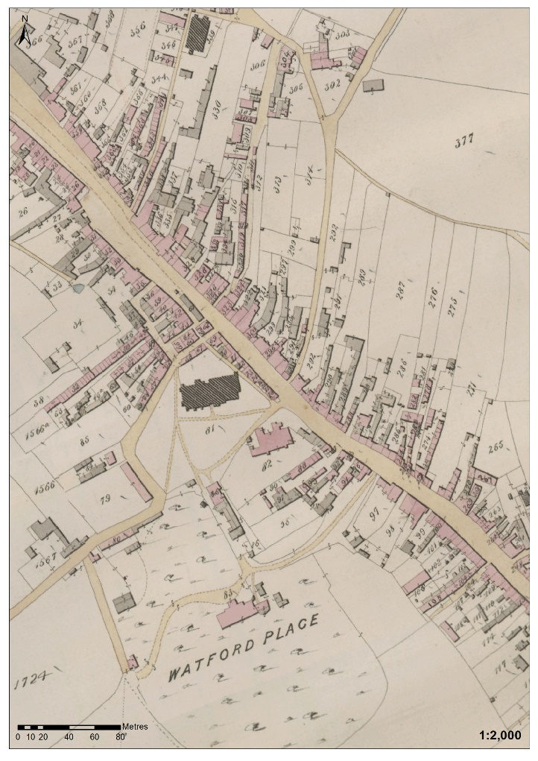
This is part of a tithe map of Watford town centre from 1842. You can see that Watford was mostly one street at this time.
.

Slide 5
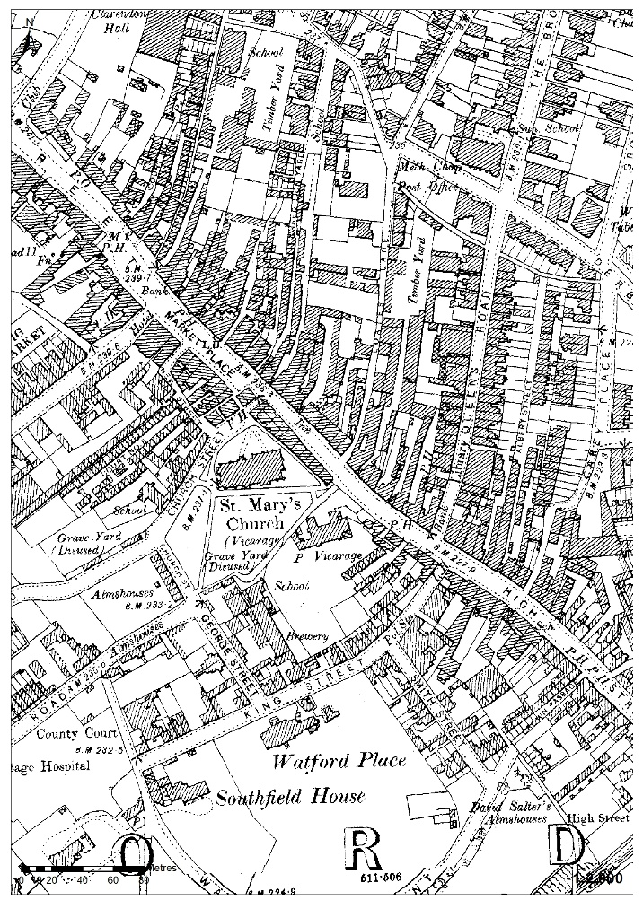
This is a map of the same areaof Watford town centre in the 1890s. Can you see how the area has changed ?
.

Slide 6
The Industrial revolution saw a move away from farming and the growth of industry
These were very interconnected
As more food was needed, labour saving machines were introduced
These machines meant fewer people were needed in the fields
So these people moved to the towns for work
They needed somewhere to live
So farm land was sold to build houses

Slide 7
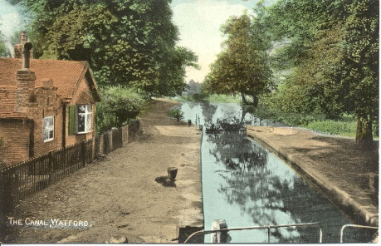
Lets rewind a little
The coming of the railways in 1837 to Watford is very important but other developments happened before 1837
The Grand union canal was opened in 1805 near to Cassiobury Park
The canal meant that coal, building materials and foods could now be delivered in large quantities

Slide 8
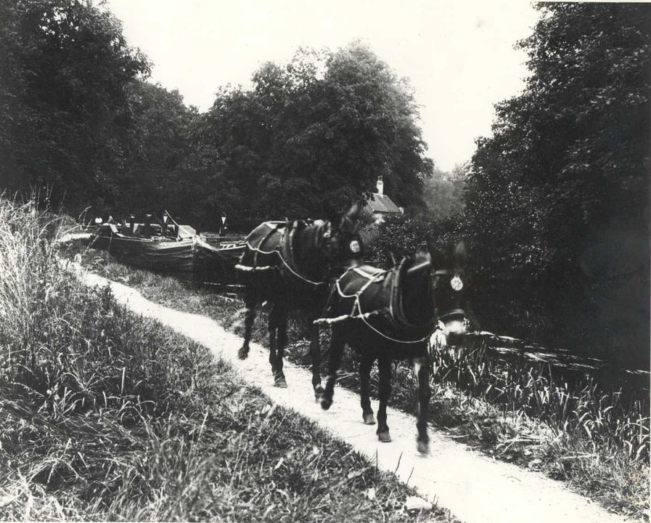
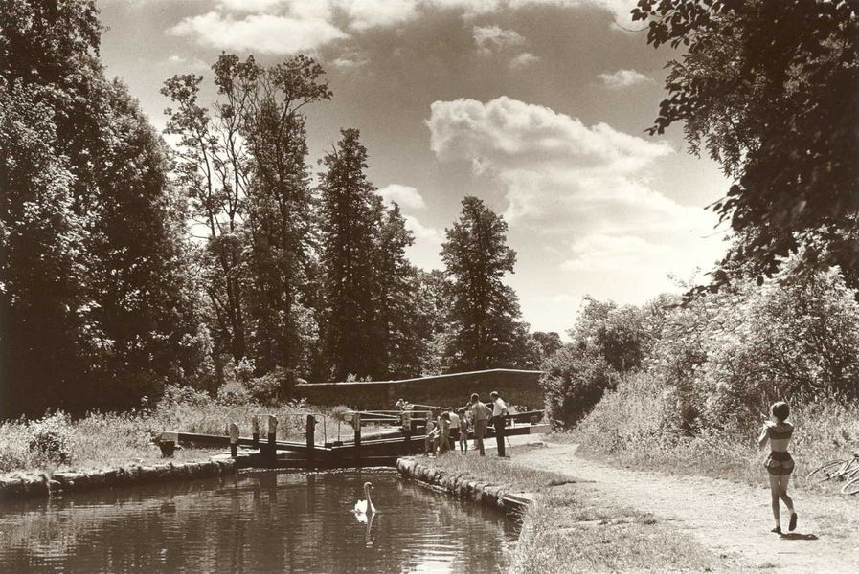
The canal near Watford
It was said that “canal mania” gripped those who owned land and industries in this early part of the Industrial revolution.
However when the railways came, they were much more efficient at transporting goods and materials. So the canals declined.

Slide 9
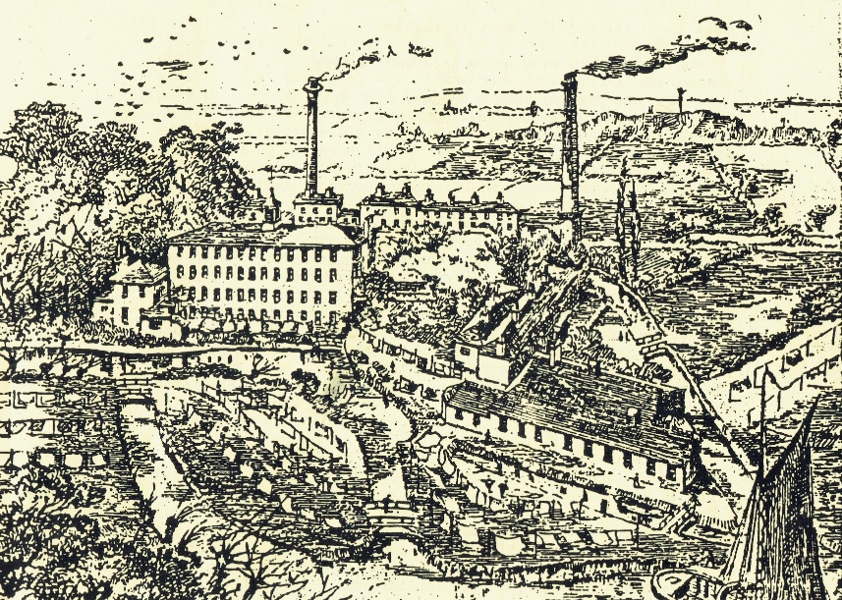
Lets rewind a little
The coming of the railways in 1837 to Watford is very important but other developments happened before 1837
The silk mills started in the 1770’s.
One of the watermills changed from corn grinding to papermaking in the 1790’s,
Dickenson expanding his papermaking business, opening at Croxley Mills in 1829
This is the Rookery Silk Mill when in use by Watford Steam Laundry

Slide 10
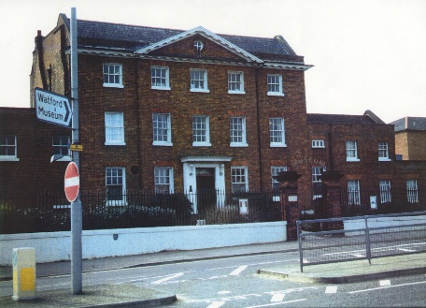
Lets rewind a little
The coming of the railways in 1837 to Watford is very important but other developments happened before 1837
Brewing was a vital part of Watford’s growth
We first hear about brewing in Watford in 1605 !
Did you know Watford Museum is housed in the former offices of Benskins brewery, which had originally been a family home ?
The house built in 1775 for Edmund Dawson, a brewer from Southwark , then the Dysons and Canon brewery was built behind
Benskins came in 1867 . By the 1900’s, Benskins brewery had 50 horses & drays and an output of over 3000 barrels a week
It was made into Watford Museum which was opened in 1981

Slide 11
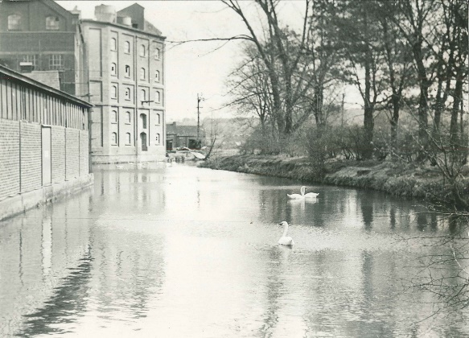
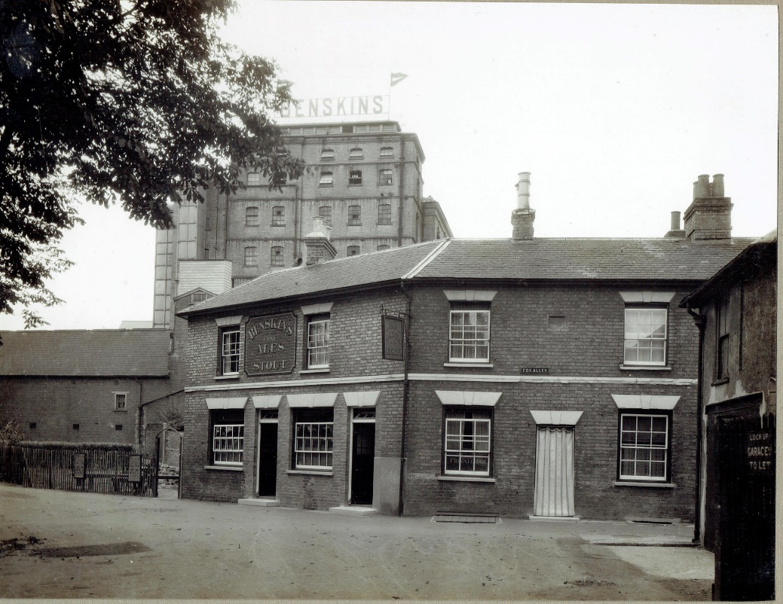
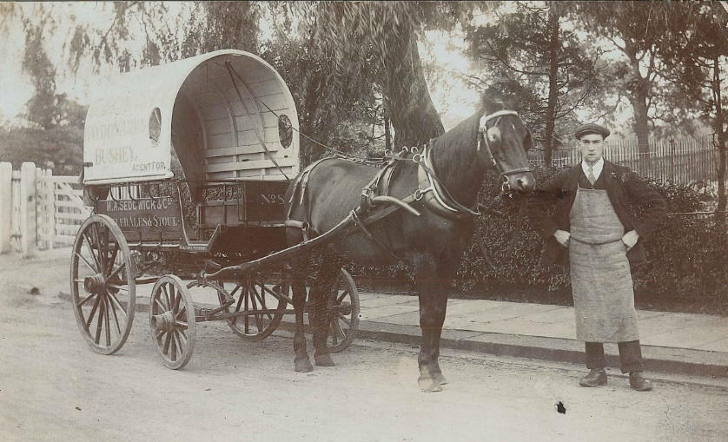
Brewing provided many jobs in Watford
There were other breweries like Sedgwicks too
( seen here on the right)

Slide 12
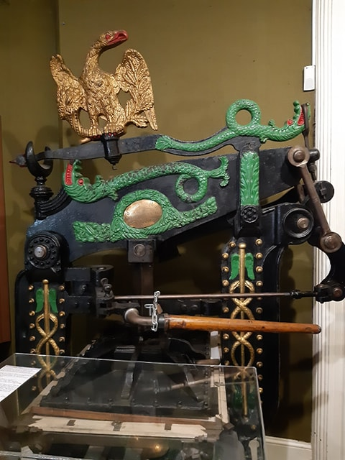
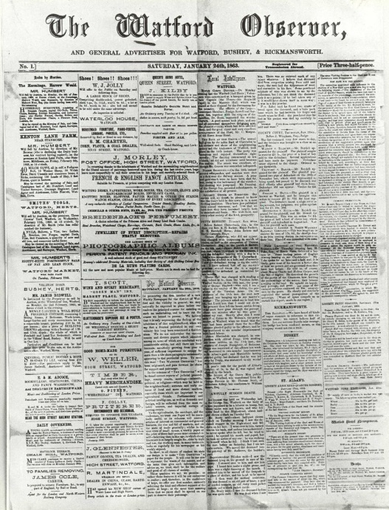
Printing was another big growth area and employer in Watford
The Watford observer started in 1863 ( there was some printing in Watford from the 1800s though)
With thanks to the Watford observer
At Watford Museum we have the Columbian Press. This was used to print the first ever edition of the Watford Observer in 1863 (see above)

Slide 13
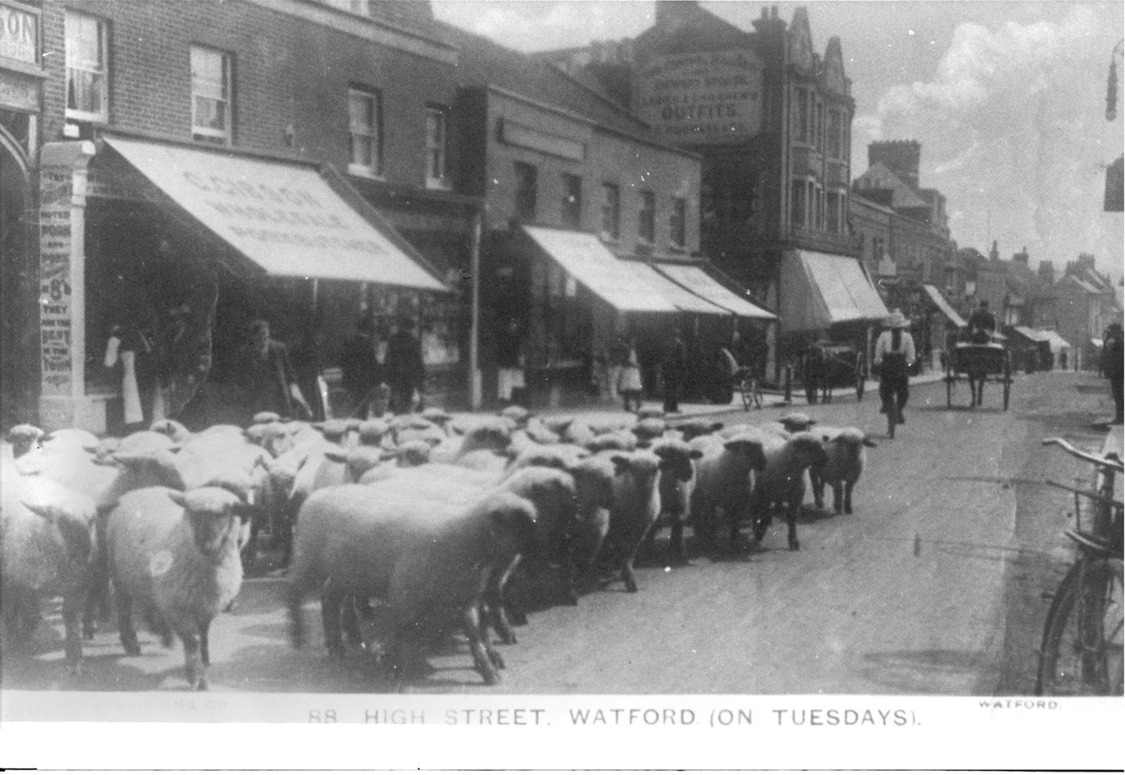
With the increase in people now working and living in Watford , other areas of everyday life changed
We think Watford has been a market town since a charter was granted to the Abbot of St Albans in the 12th century.
The last charter market was in 1928 .
Livestock were sold on Tuesdays and general goods on Saturdays
As the town grew , new shops were created

Slide 14
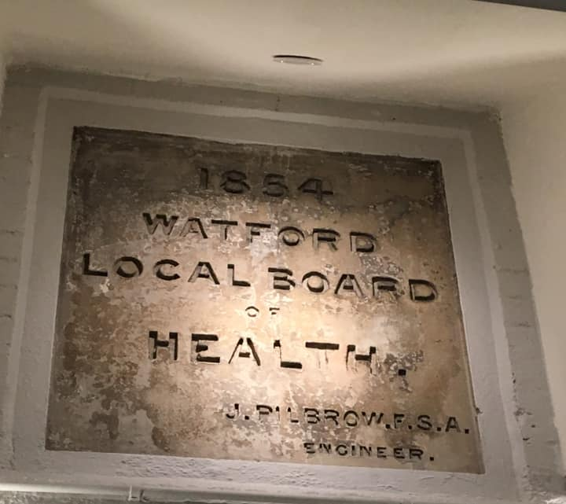
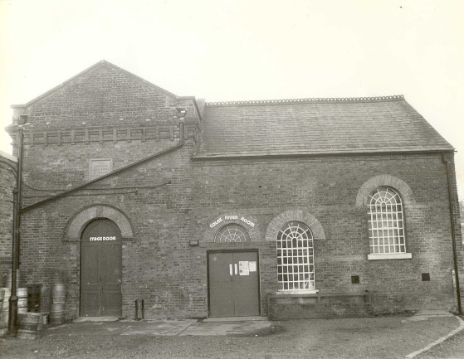
With the increase in people now working and living in Watford , other areas of everyday life changed
In 1849 there was a report into the sewage, drainage, water supply and sanitary conditions of the people of Watford
In 1850 the Watford board of health was set up.
Did you know The Pump House Theatre and Arts Centre used to be the old pumping station supplying water to the Watford area !

Slide 15
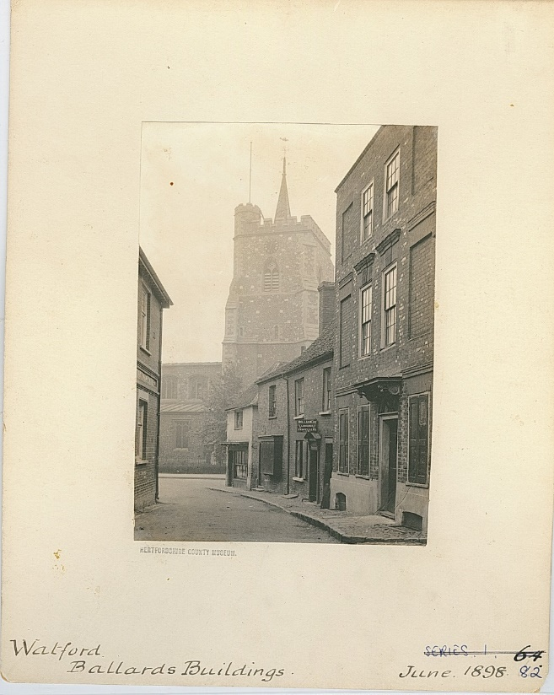
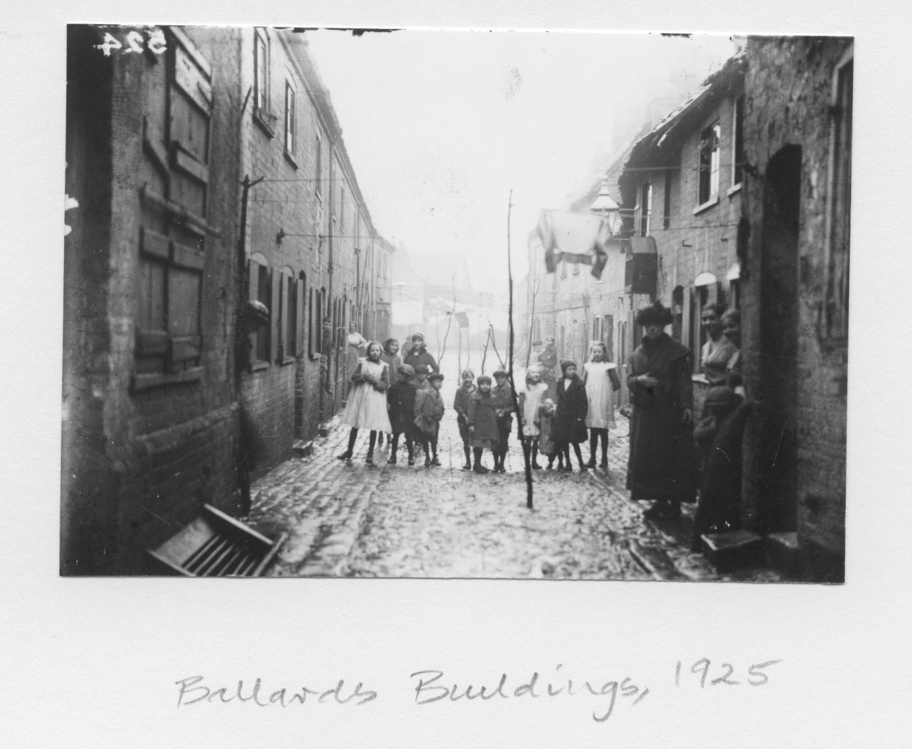
Here is a photo by Whitford Anderson
New Street - Ballards Buildings June 1898 (left) and again in 1925
Charities and welfare were set up to help people

Slide 16
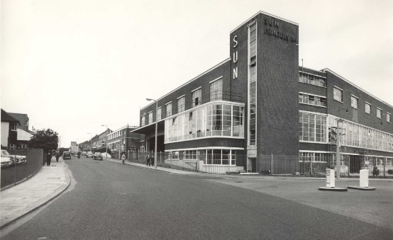
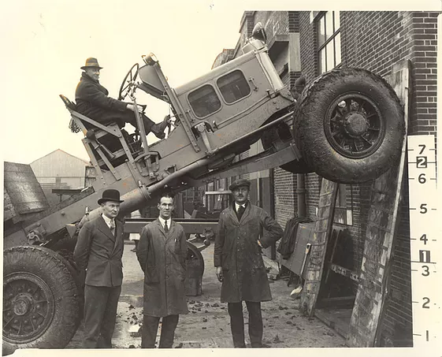
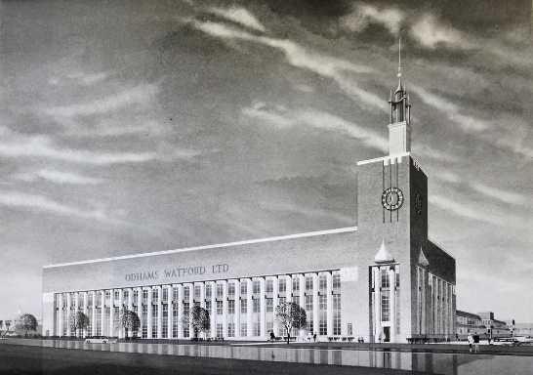
Watford kept growing
Sun printers opened in 1919 Roads improved
Bigger and better shops
Odhams opened in 1920
Scammells opened in 1922

Slide 17
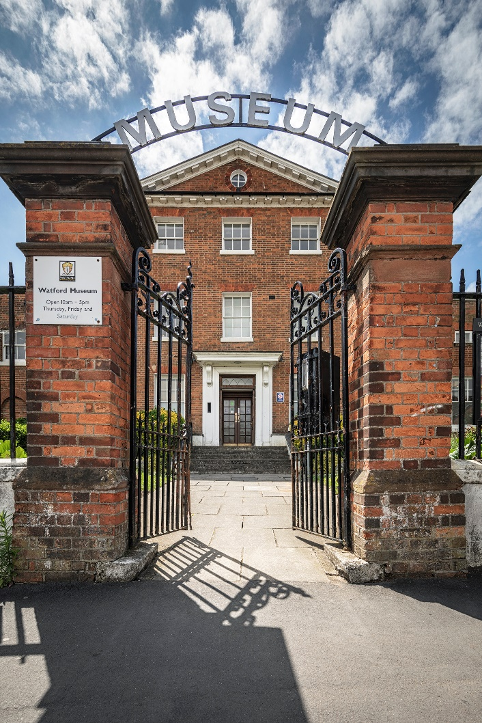
Thank You!
Watford Museum
Open Thursday to Saturday
10am – 5pm
Admission Free
www.watfordmuseum.org.uk

