Slide 1
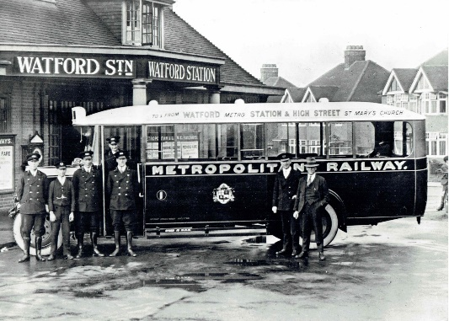
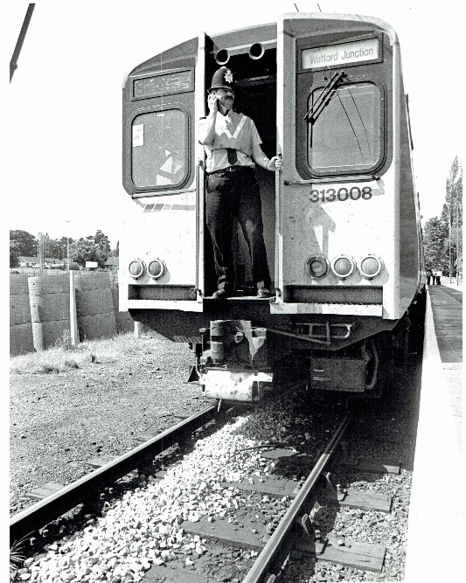
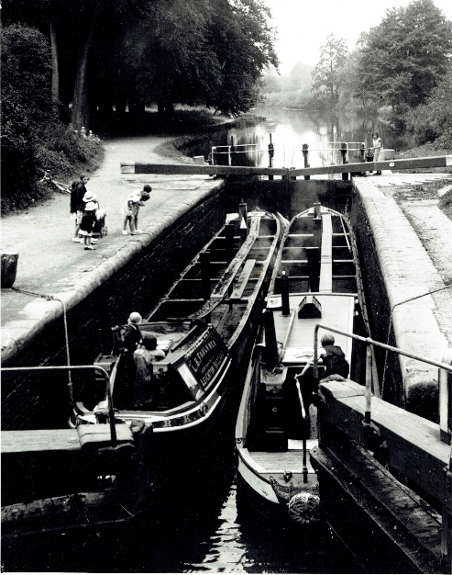
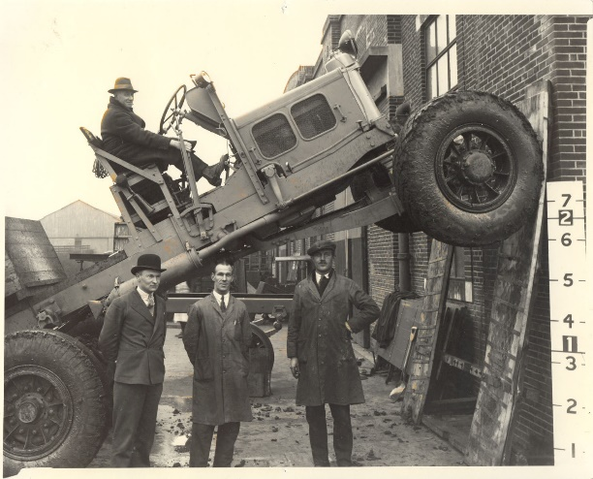
Transport in Watford
Photos of canals, buses, railways and Scammell’s lorries from Watford’s past

Slide 2
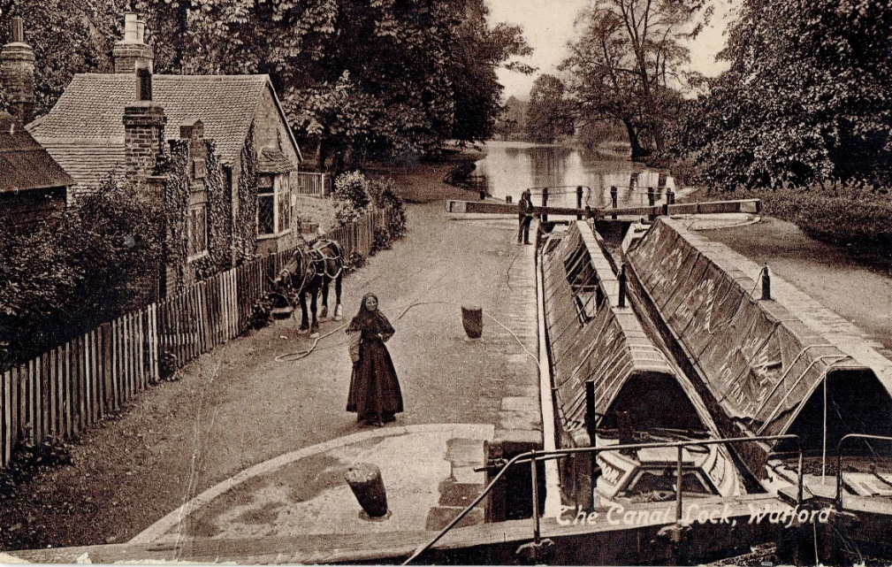
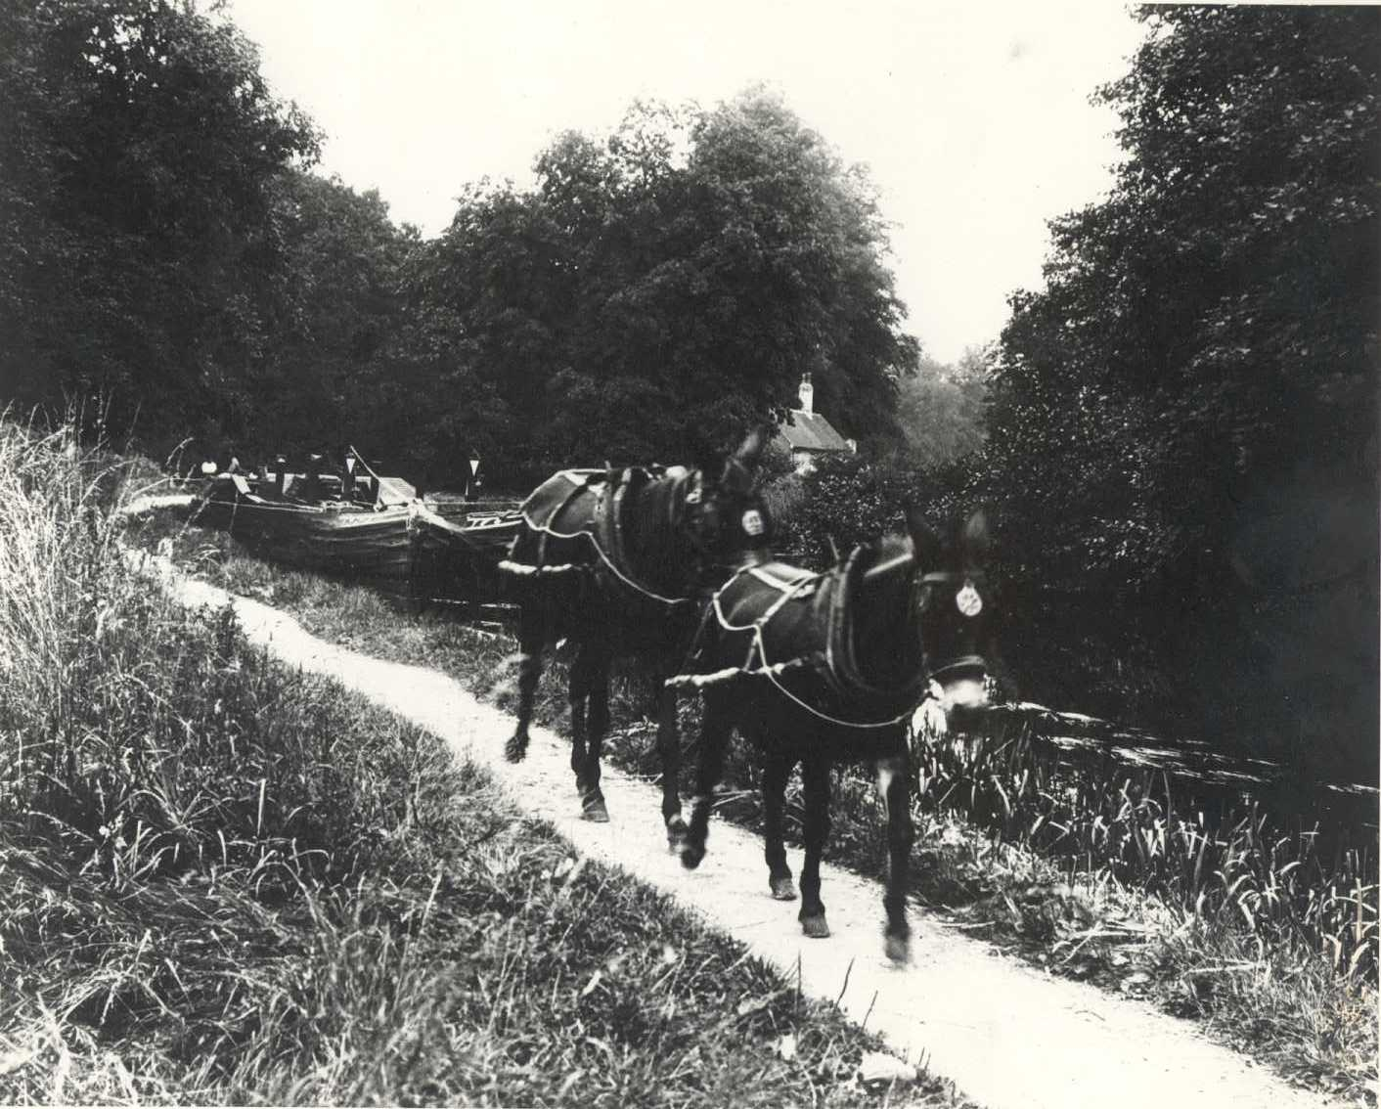
Canals
1900’s Grand Union canal Horse-drawn barges

Slide 3
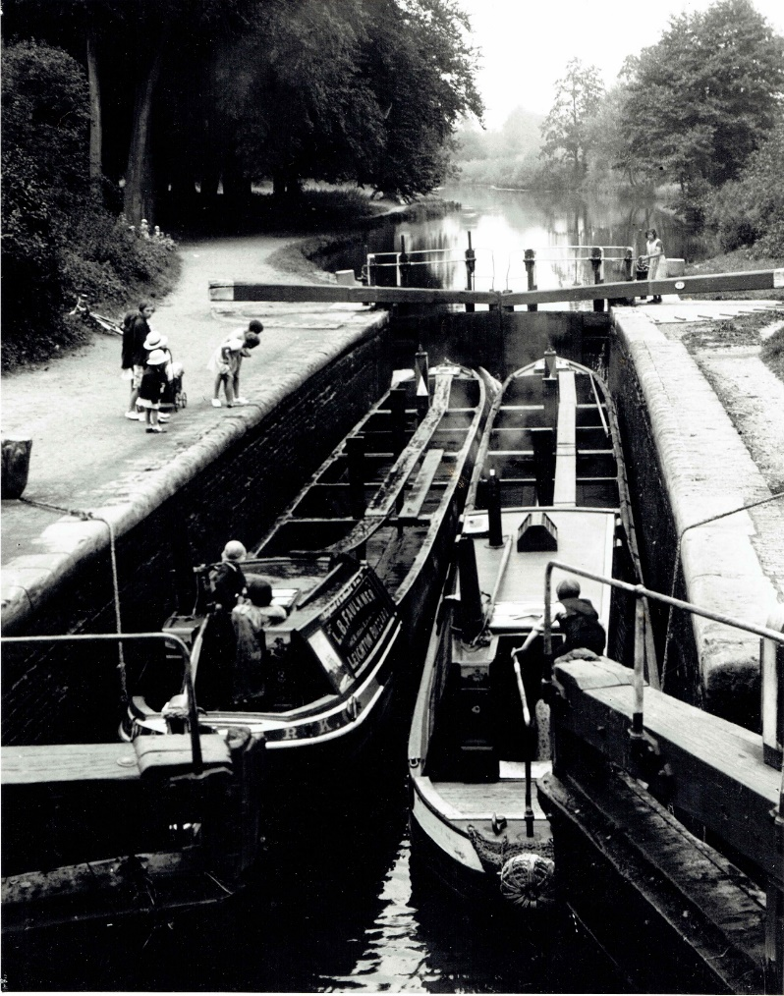
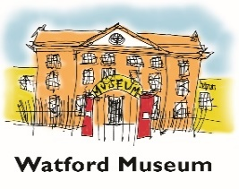
Canals
A lock on the Grand Union Canal in the 1920’s

Slide 4
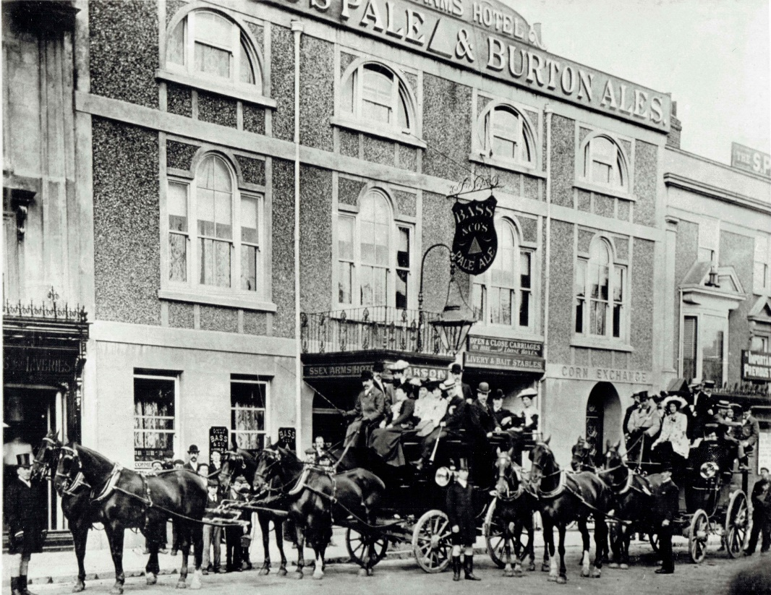
Buses 1886 saw the last regular horse-drawn coach service, ‘The Wonder Coach’, between Watford and London. It operated between London and St. Albans, with a single fare priced at ten shillings and a return at fifteen. Six horses were drawn up Holywell Hill in St. Albans and time was given for passengers to have lunch and inspect the cathedral. This ‘Wonder Coach’ continued to carry passengers until the early twentieth century due to the internal combustion engine and motor coaches.

Slide 5
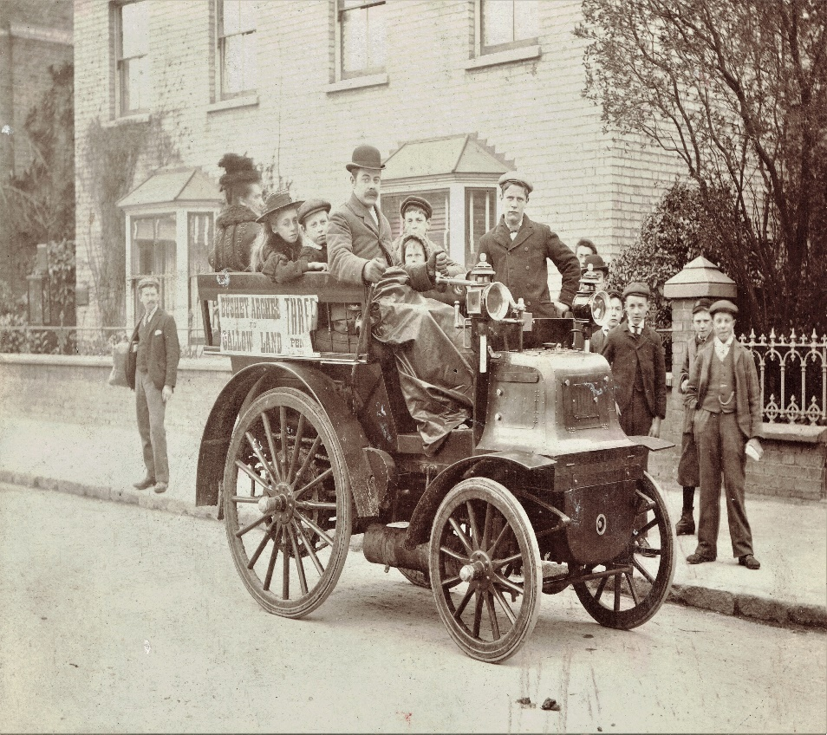
Buses 1886 saw the last regular horse-drawn coach service, Watford’s first motor bus operated from 1898 and ran from Bushey Arches to the water trough in Callowland. There was no cover and candles were used for lighting. When the bus first started in Watford , the only means of public road travel in the town were two horse drawn buses run by the owner of the Essex arms. The top speed of the bus was at 10 mph, which was faster than the horse drawn buses that were being used. The LNW railway began running motor buses in Watford in 1906.

Slide 6
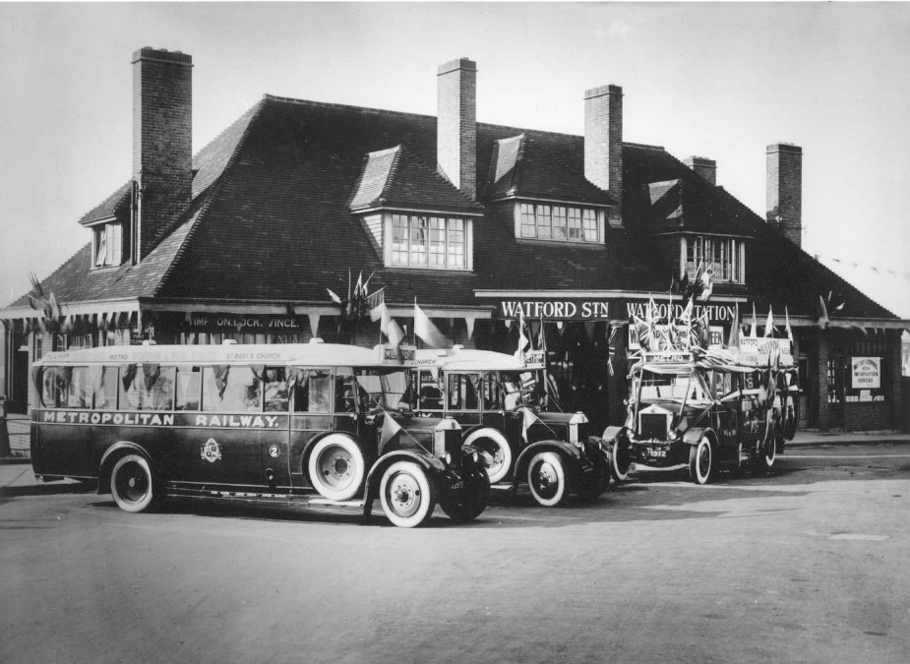
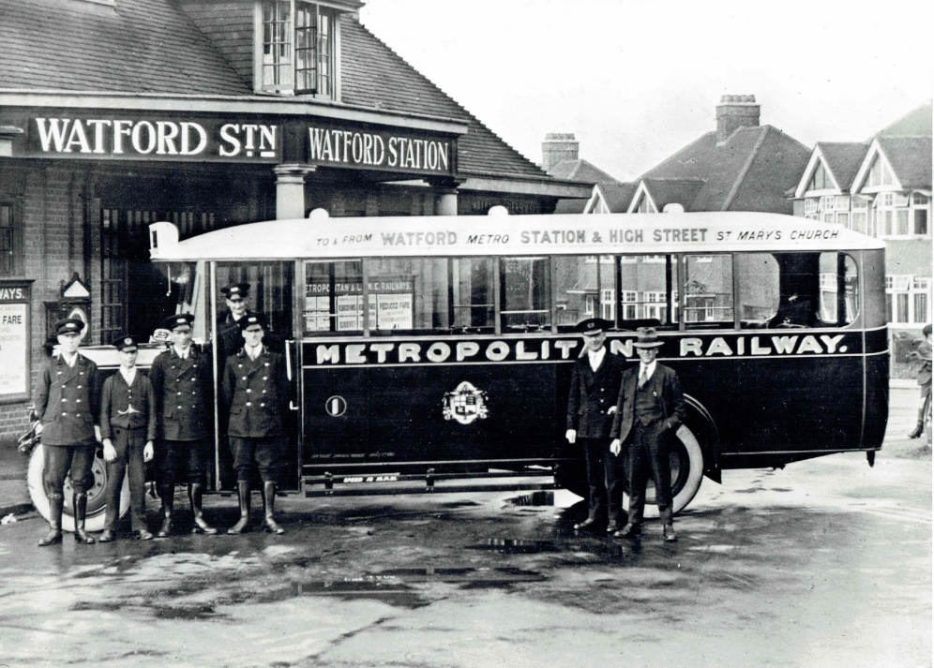
Buses
These buses are from the 1920’s

Slide 7
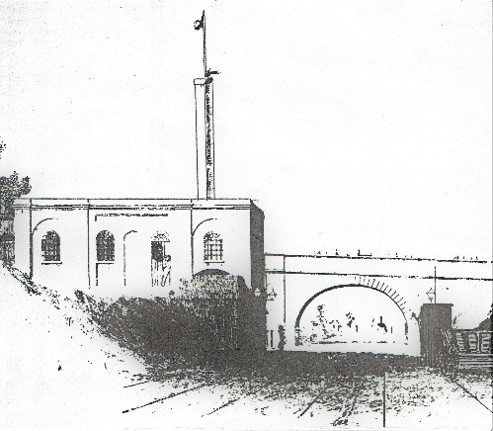
Railway
The London and Birmingham Railway opened on 20 July 1837 and ran between Euston and Boxmoor. In 1837 the town’s first railway station was opened on a site next to the bridge in St. Albans Road. The station had first and second-class waiting rooms, departure yard, carriage shed, engine house and facilities for pumping water. In 1843 even Queen Victoria and Prince Albert took the train from Watford Station.
First Watford station between London and Birmingham

Slide 8
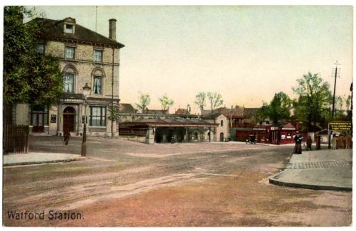
Early images of Watford station
In 1860 In 1905

Slide 9
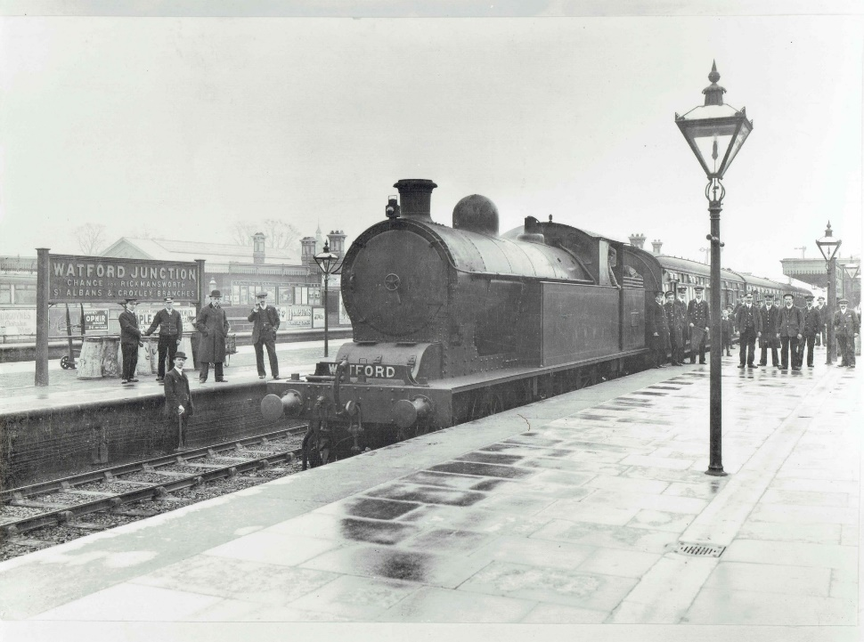
Photos of Watford Junction station In 1905 In 1976

Slide 10
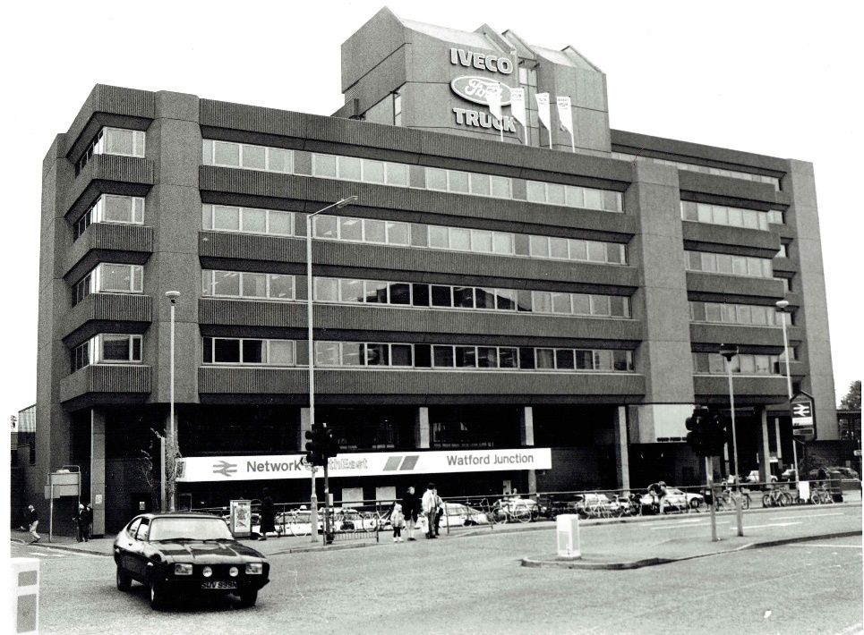
Watford Junction station in 1979 A 1980’s train

Slide 11
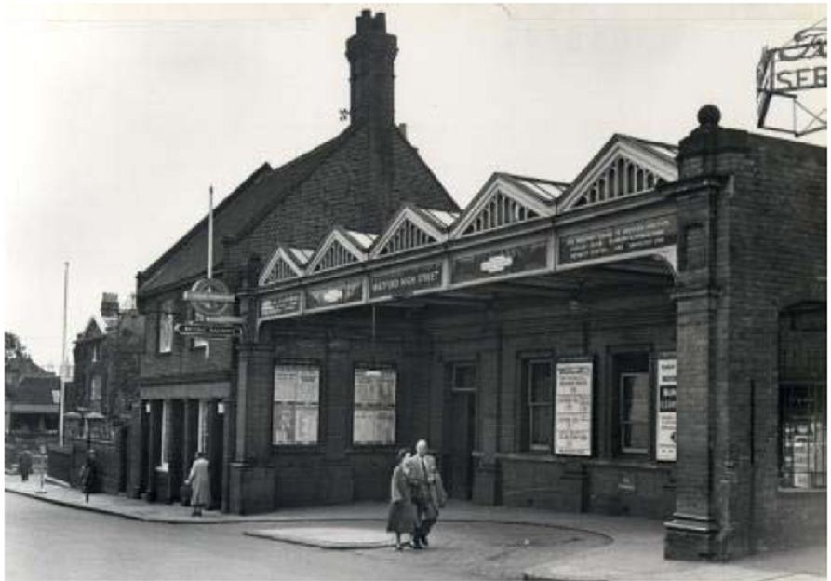
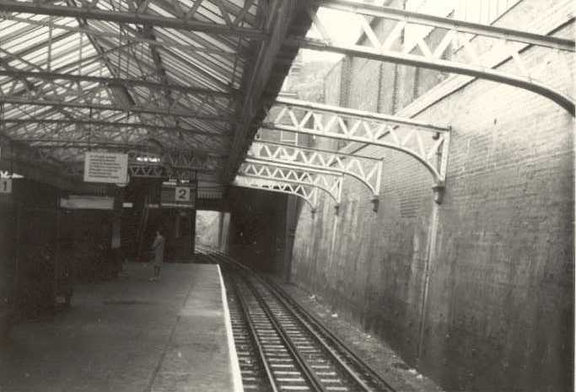
High street station In 1956 A platform in 1973

Slide 12
Scammell Lorries Mr Pugh the designer of the Pioneer in 1929

Slide 13
Scammell Lorries This is a photo of Scammell’s factory from 1945 – 50

