Slide 1
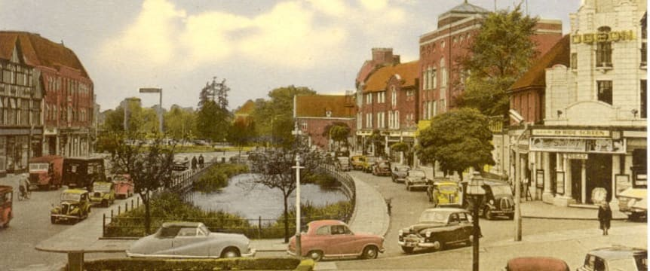
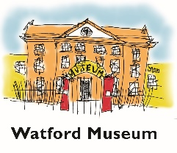
Conservation areas in Watford
Watford Borough has 10 heritage conservation areas These were designated to protect areas of special architectural or historic interest.
This year there has been a review of a document called the Conservation Areas management plan, which was created in 2013. This plan set out Watford Borough Council’s approach for preserving and enhancing conservation areas.
Much useful information has been gathered and published during this process. It has been collated in the related presentation to support learning about the local area

Slide 2
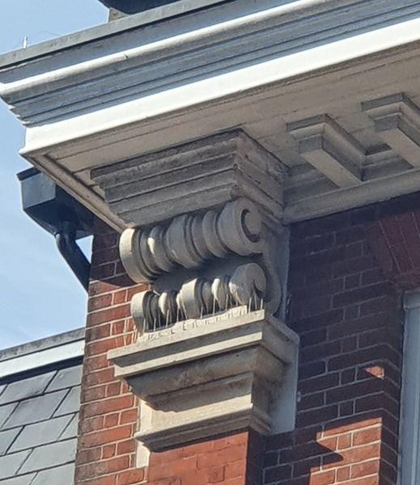
Which is this building in the King Street conservation area ?

Slide 3
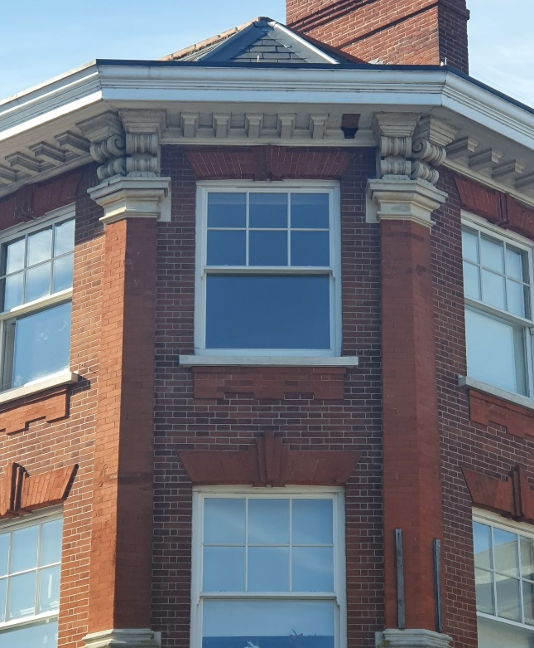
Which is this building in the King Street conservation area ?

Slide 4
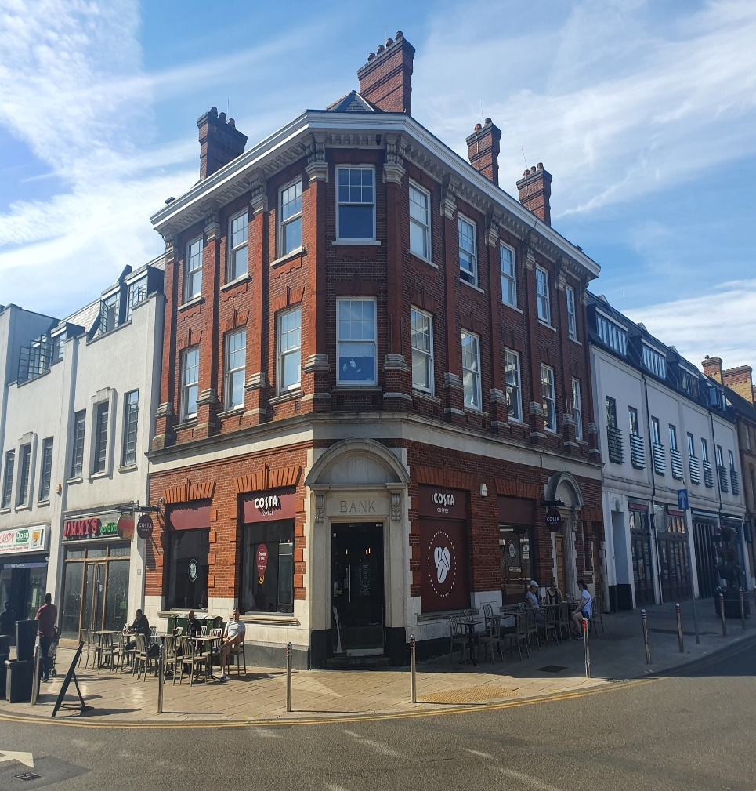
Did you guess ?
This building is 132 High Street in the King Street Conservation Area
You can see the former use of this building from the word ‘BANK’ above the main entrance.
It was built in 1912 for Barclays Bank.
It was designed by Charles Ayres, a local architect.
.

Slide 5
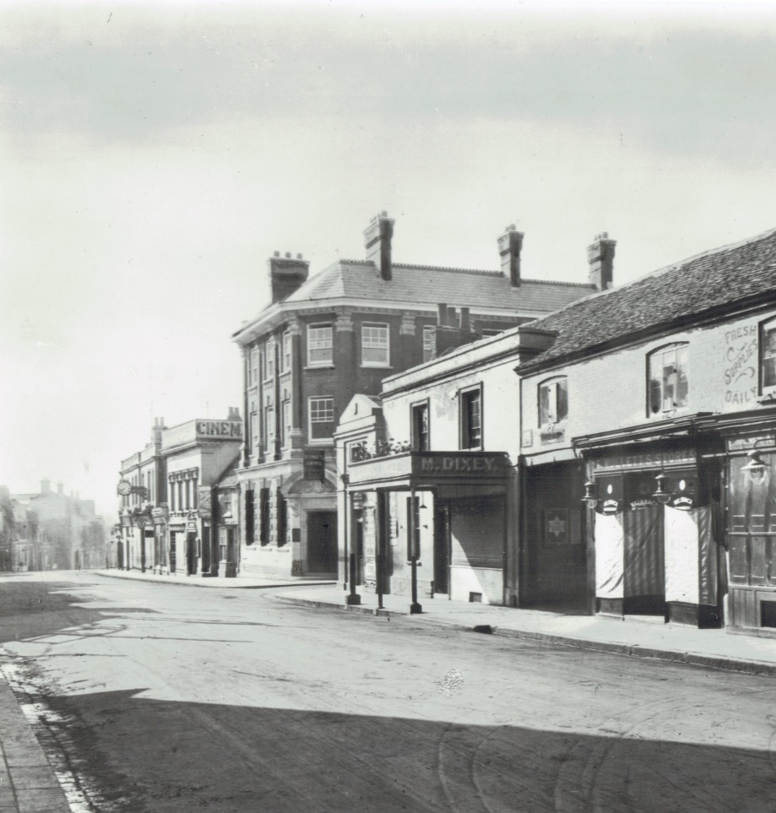
This is an older photo of 132 High Street in the King Street Conservation Area

Slide 6
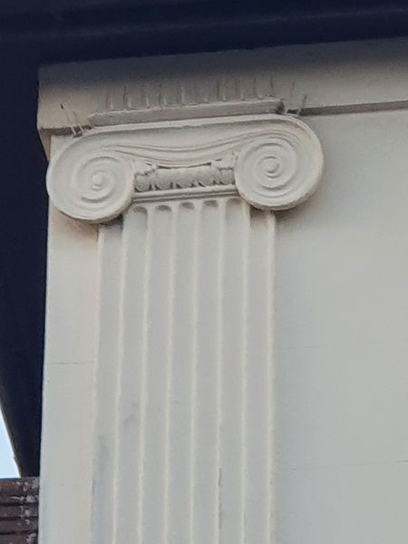
Which is this building in the King Street conservation area ?

Slide 7
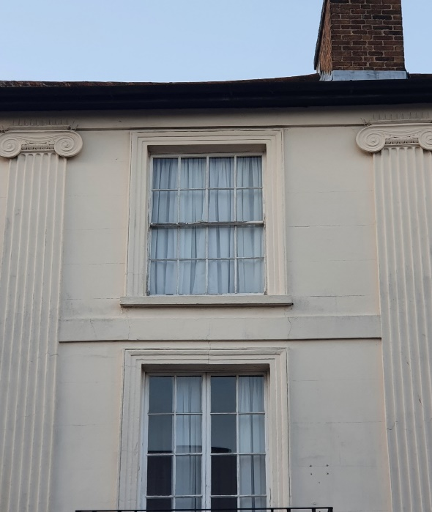
Which is this building in the King Street conservation area ?

Slide 8
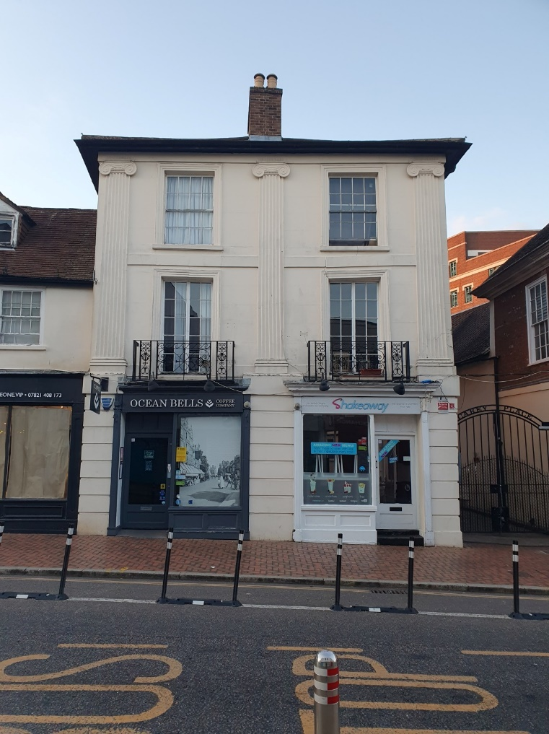
Did you guess ?
This is 133-135 High Street located in the King St Conservation Area.
This shop was originally built as a town house between 1830-1850.
It would have been quite different looking from its much older and shorter neighbours.
It was converted to shops likely later in the 1800s when the High Street expanded. It is Grade II Listed
.

Slide 9
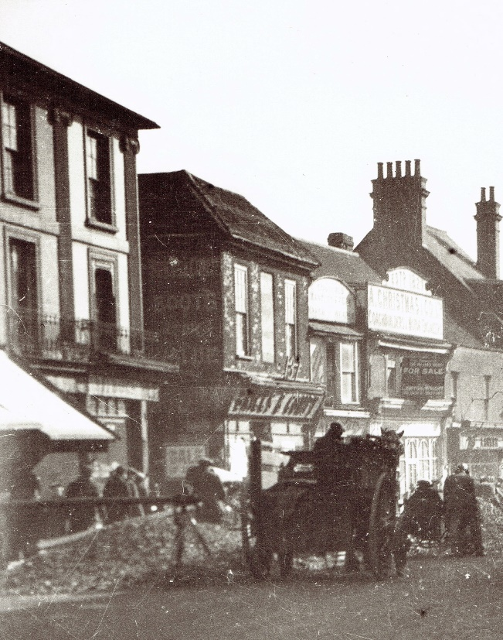
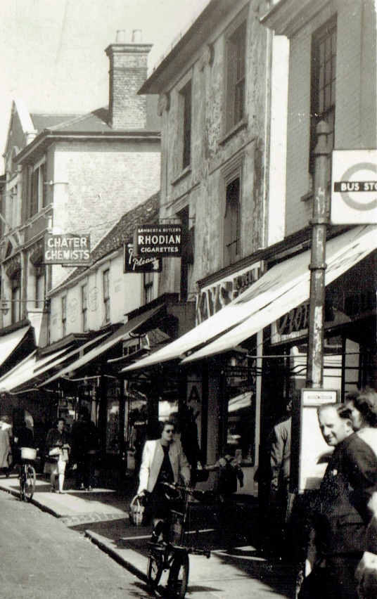
These older photos of 133-135 High Street located in the King St Conservation Area.

Slide 10
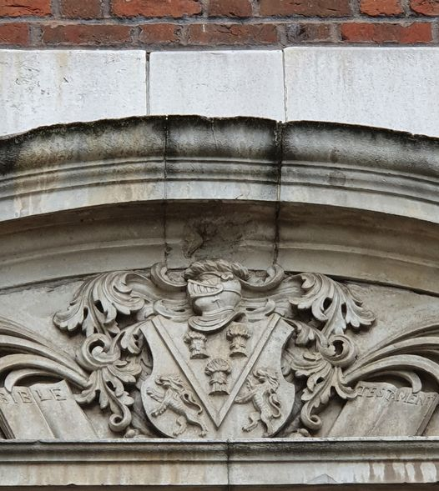
Which is this building in St Marys conservation area ? .

Slide 11
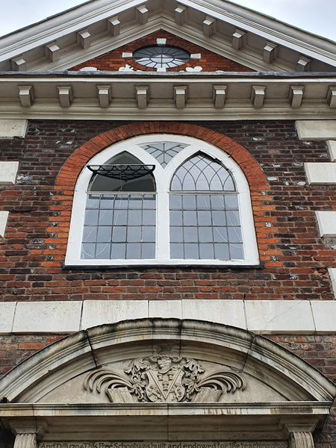
Which is this building in St Marys conservation area ? .

Slide 12
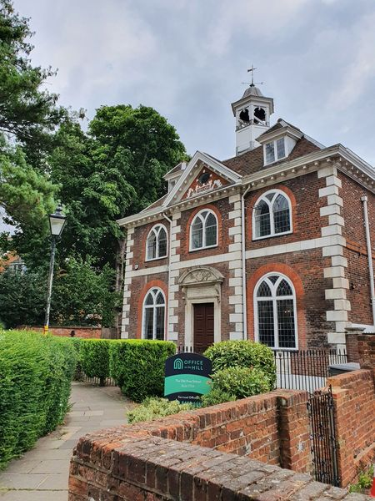
Did you guess ?
It is Fuller Free School, Church Street in the St Marys Conservation Area.
The school was built in 1704 paid for by Mrs. Elizabeth Fuller of Watford Place.
Mrs. Fuller endowed it as a Free School for the teaching of poor children.
Both Watford Grammar School for Boys and Watford Grammar School for Girls have their roots in the establishment of this school.
It is Grade II Listed.
.

Slide 13
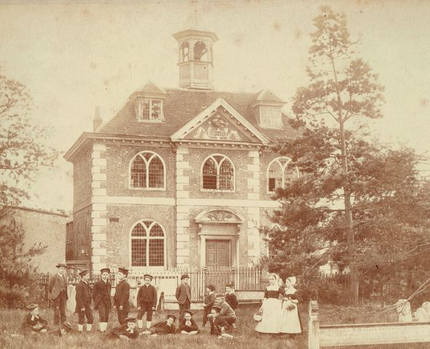
This historical photo of the Fuller Free school was taken 1882, by F Downer and Sons

Slide 14
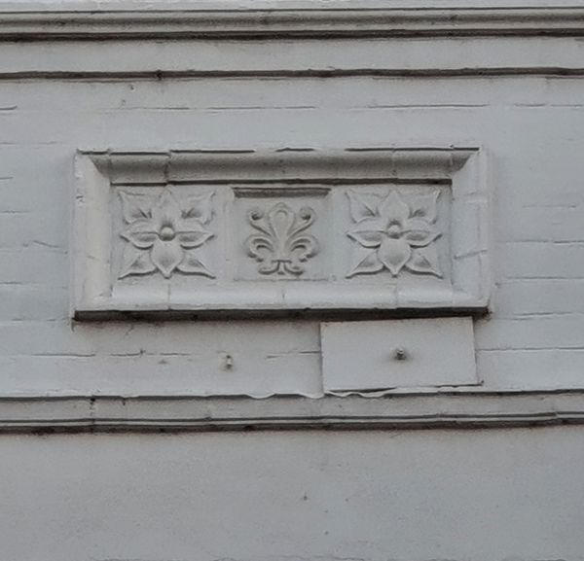
Which is this building in St Marys conservation area ? .

Slide 15
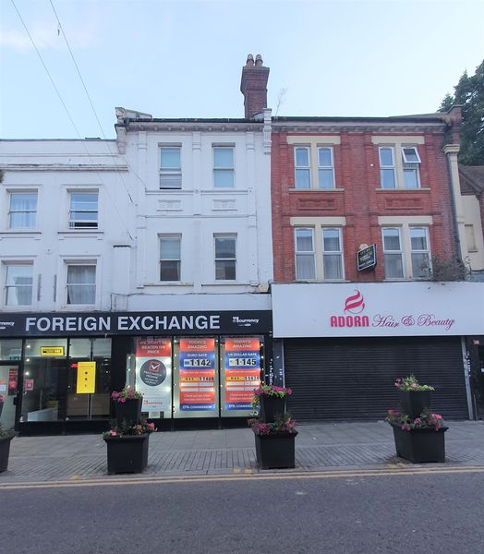
Did you guess ?
It is 106 High Street in the St. Mary’s Conservation Area.
This shop was built in 1904 along with its neighbour.
The building used the foundations of a previous building, and so the cellar may be considerably older.
It was designed by local architect Charles Ayres
It is locally listed.
.

Slide 16
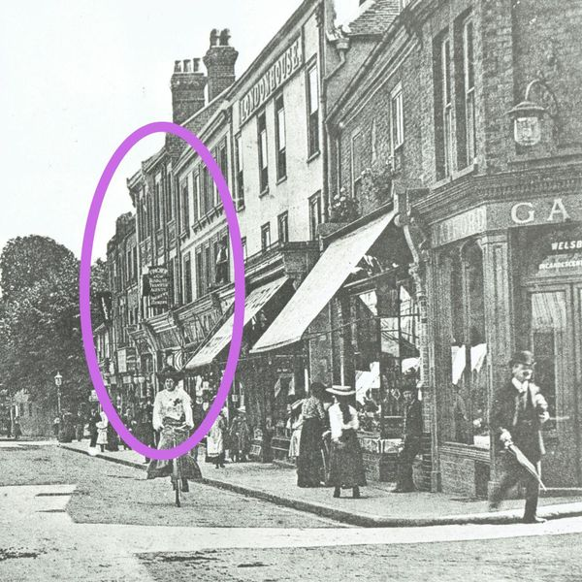
This is an older photo of 106 High Street in the St. Mary’s Conservation Area

Slide 17
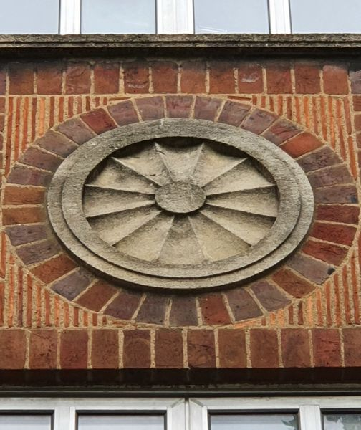
Which is building in the Civic core conservation area ? .

Slide 18
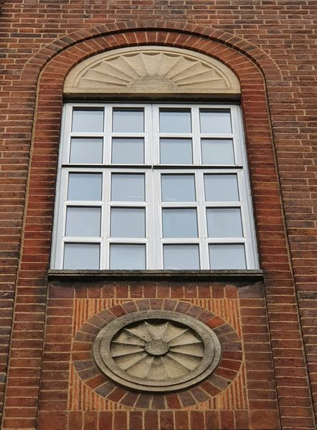
Which is building in the Civic core conservation area ? .

Slide 19
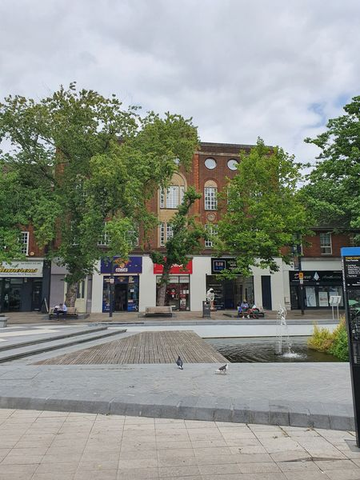
Did you guess ?
This is 135 The Parade in the Civic Core Conservation Area.
This building was designed in 1938 by the Watford Borough Engineer W.W. Newman.
It was built as the central offices and showroom for the municipal electricity supplier.
It was built using modern construction methods including fours storey steel frame with brick exterior walls.
The building is locally listed.
.

Slide 20
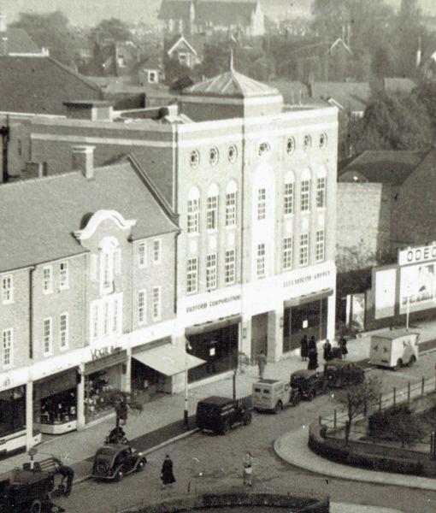
This is an historical photo from the 1940s of 135 The Parade in the Civic Core Conservation Area.

Slide 21
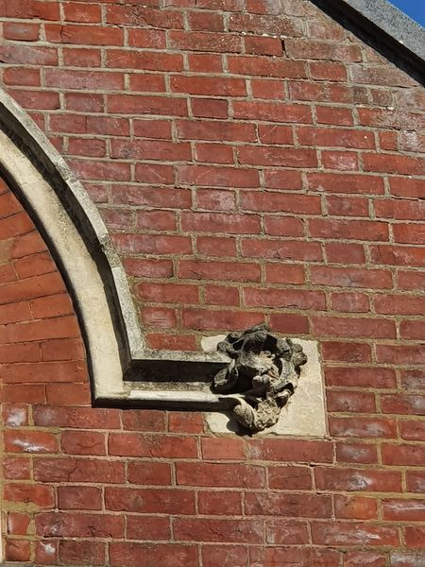
Which is this building in the Estcourt conservation area ?
.

Slide 22
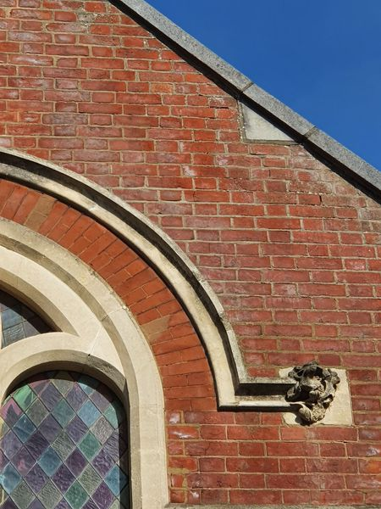
Which is this building in the Estcourt conservation area ?
.

Slide 23
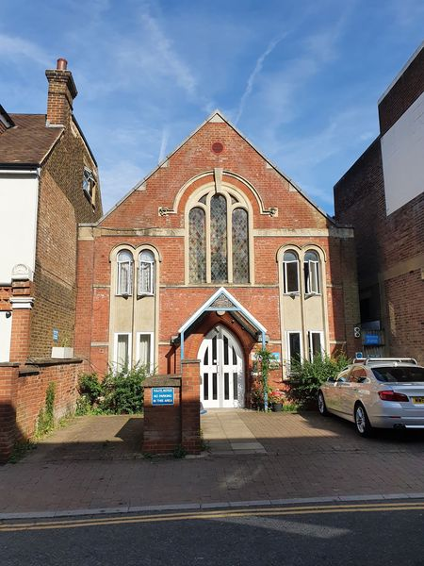
Did you guess ?
This building is 69 Queens Road in the Estcourt Conservation Area
.
This chapel was built for the strict Baptists between 1884-1885 and was known as Mount Zion Baptist Church
Charles R. Lovejoy was its architect.
The chapel was converted to a hostel during the 1990s.
It is locally listed.
.

Slide 24
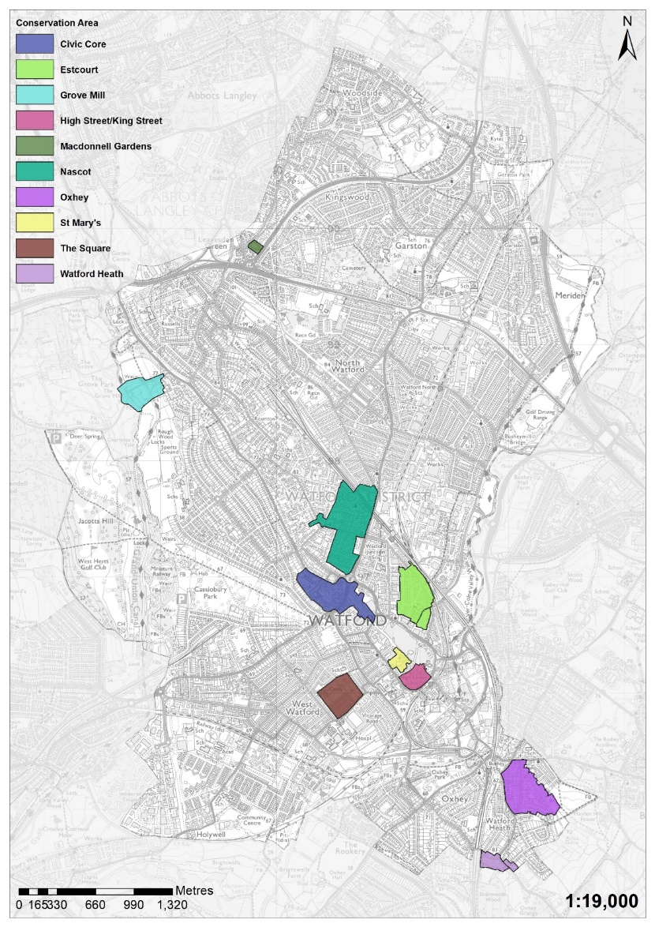
Watford Borough has 10 heritage
conservation areas.
Conservation areas exist to manage
and protect the special architectural
and historic interest of a place –
in other words,
the features that make it unique.
Every local authority in England has at least
one conservation area and there
are around 10,000 in England.
4 of the conservation areas mentioned
in the Guess the building are covered in
the next slides

Slide 25
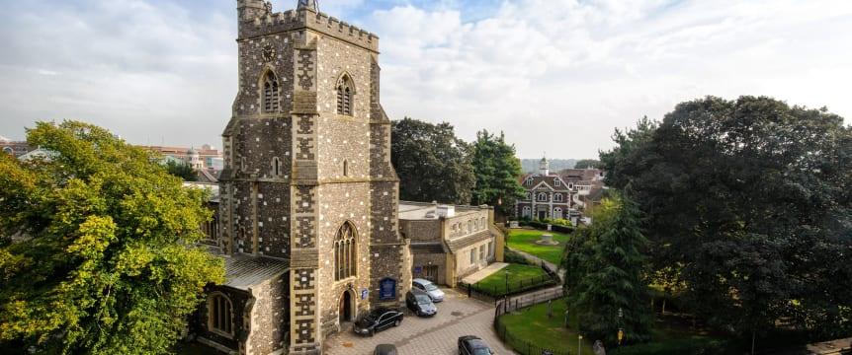
St Marys
St Mary’s Conservation Area marks the historic centre of Watford. It contains St Mary’s Church, Watford’s oldest standing building, and other notable buildings such as the Elizabeth Fuller Free School and the Bedford Almshouses. Local welfare and educational provision in the town originated from this area and it continues to be a focal point of the town.
The enclosed nature of the conservation area, with its trees and ancient buildings, contrasts the open bustle of the High Street

Slide 26
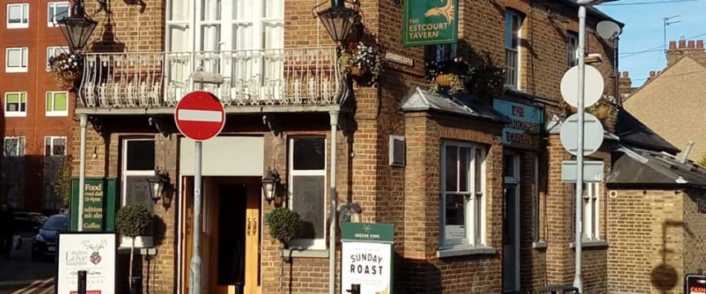
Estcourt Conservation Area
Estcourt was originally farmland, and was developed following the opening of the railway station at Watford Junction in 1858.
Estcourt stands out from other Victorian areas of the town because of the mix of uses it had within the area; terraced housing interspersed with small workshops and yards, as well as a wide variety of public houses, independent shops and public buildings.

Slide 27
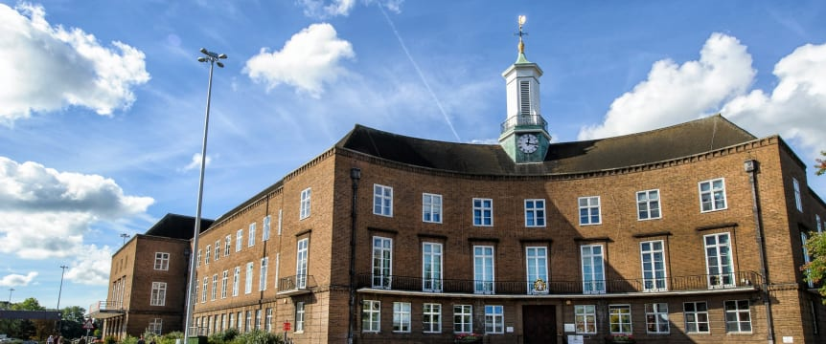
Civic core
The Civic Core Conservation area contains Watford’s main civic buildings and marks the northern limit of the town’s medieval settlement.
The conservation area follows the path of a historically important road and contains a number of nationally listed buildings. These include ‘Little Cassiobury’, a former Dower House of the Cassiobury Estate, which dates back to the late 17th century, and the Town Hall, which was opened in 1939.

Slide 28
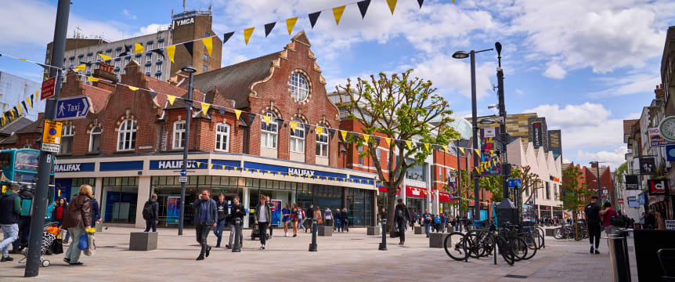
The High Street/King Street Conservation Area
The High Street/King Street Conservation Area includes the only surviving concentration of 16th and 17th century buildings in the town, at the Watford High Street Station end of the High Street.
Many of these were re-fronted in the 18th and 19th centuries, hiding their ancient origins. The area also includes an area of the 19th and 20th century expansion of the town, with buildings including a former police station, a cinema and a Georgian mansion all fronting on to King Street.

Slide 29
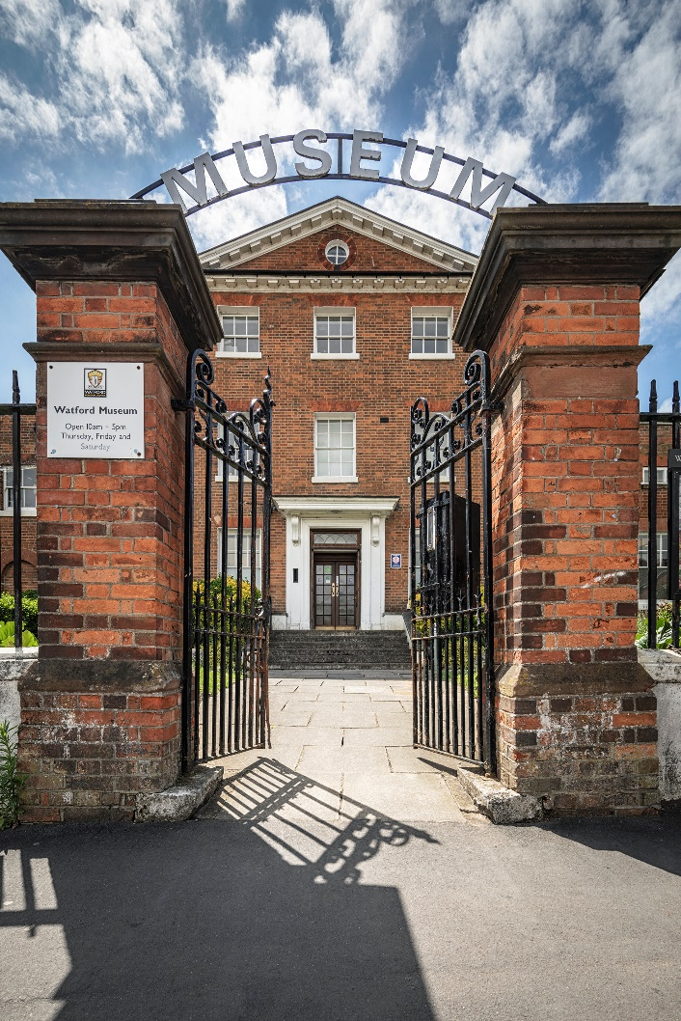
Thank You!
Watford Museum
Open Thursday to Saturday
10am – 5pm
Admission Free
www.watfordmuseum.org.uk

