Slide 1
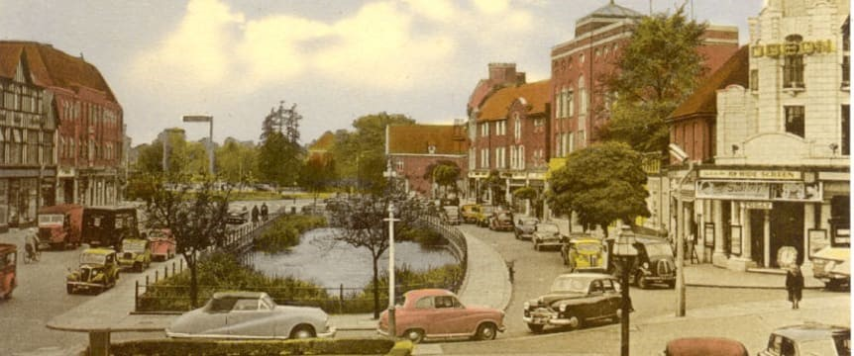
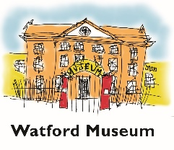
Conservation areas in Watford
Watford Borough has 10 heritage conservation areas These were designated to protect areas of special architectural or historic interest.
This year there has been a review of a document called the Conservation Areas management plan, which was created in 2013. This plan set out Watford Borough Council’s approach for preserving and enhancing conservation areas.
Much useful information has been gathered and published during this process. It has been collated in the related presentation to support learning about the local area

Slide 2
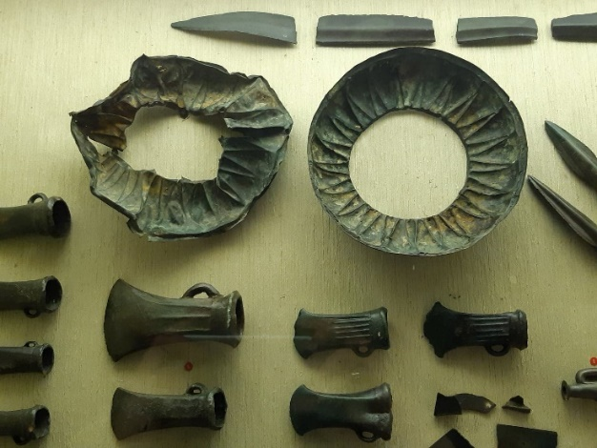
Watford history Watford way back
It is thought “Watford” is derived from the Anglo-Saxon name for the ford.
We think that the local area was originally a place that people travelled through to settle or trade. They did not tend to settle here because soil was not the best for farming. There was also a lot of flint
Some of these passers-by have left evidence of their time here and this can be seen in Watford Museum. These include flint tools from the Stone Age, a Bronze Age hoard and Anglo Saxon coins from the 10th Century.

Slide 3
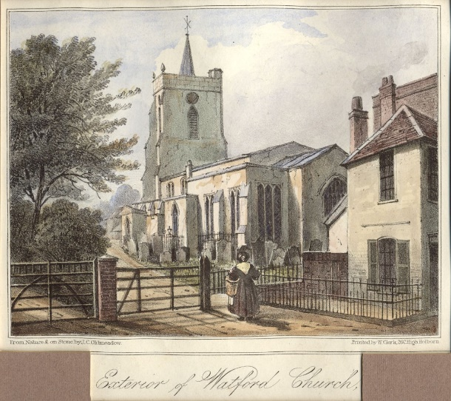
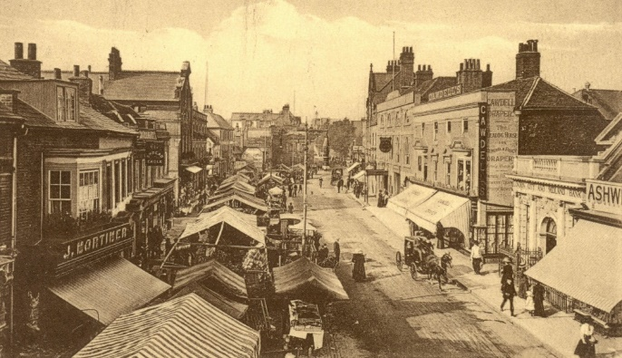
Watford history Watford continues to develop
The development of the local area continued . By the 12th century a settlement had emerged, when a market was granted to the Abbot of St. Albans as the lord of the manor.
He chose a site along a route already used by travellers, where the market continued to be held until 1928. The Abbot also arranged for the first church to be built next to the market: St Mary’s, the parish church of Watford.
Our photos show St Marys Church 1830 and the last Charter market in 1928.

Slide 4
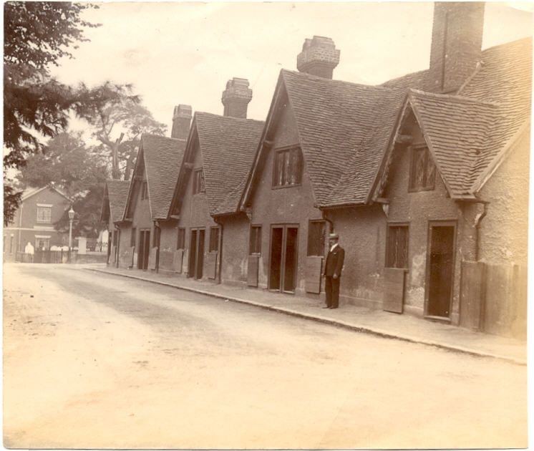
Watford history Watford continues to develop
Little remains of medieval Watford apart from St Mary’s Church.
The earliest domestic buildings to survive are the Bedford Almshouses, built near the church in 1580.
Like in most of Hertfordshire at this time, most people would have worked on the farms. Our photo shows the Bedford Almshouses

Slide 5
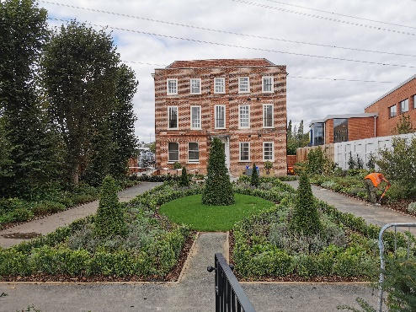
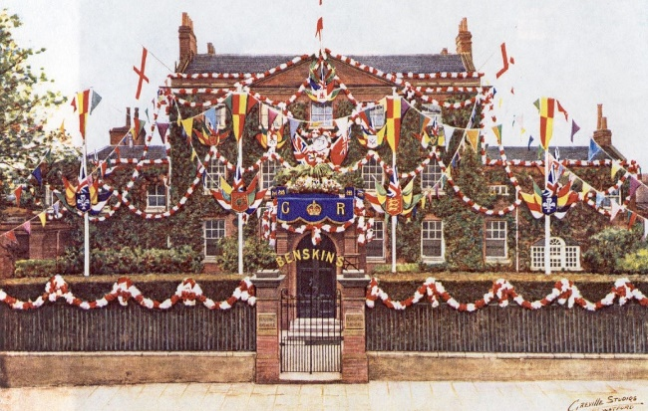
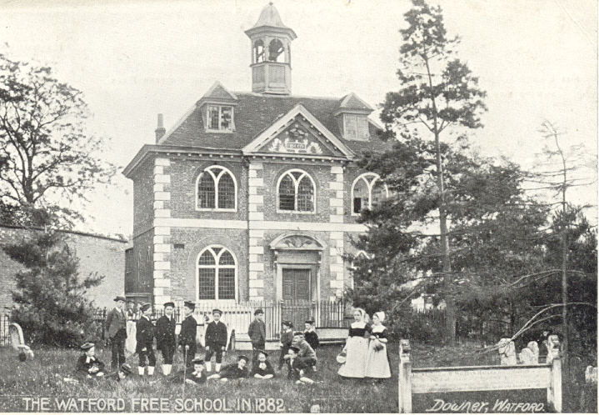
Watford history Watford in the 16th, 17th, 18th Centuries
When in the 16th century Henry VIII closed the abbeys and monasteries, he took over the land belonging to St Albans Abbey and sold Cassio to a man whose descendants became the Earls of Essex and lived at Cassiobury House.
A few buildings remain from this period: Monmouth House from the 17th century; the Free School, Frogmore House, Benskin House (now the museum), Little Cassiobury and Russells from the 18th century, and also some of the High Street shops. Our photos show a photo of Frogmore house form 2020, Benskin house during the Silver Jubilee and the Free school in 1882
.

Slide 6
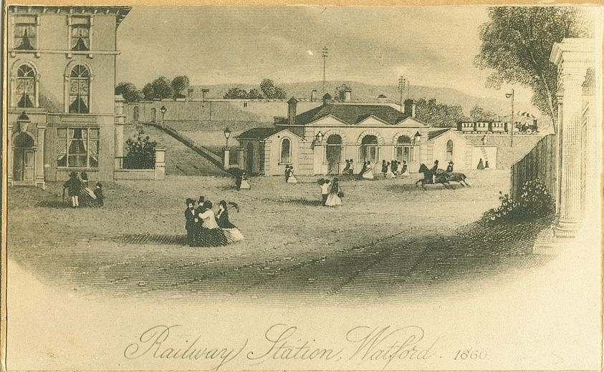
Watford history Watford after the railways came
The early 1800s which saw the greatest and most rapid changes in Watford . The Grand Union Canal brought goods not easily available before.
The opening of the railway in 1837 was even more important to the growth of Watford
The railways developed links to London, the West Midlands and Lancashire encouraged new industry here.

Slide 7
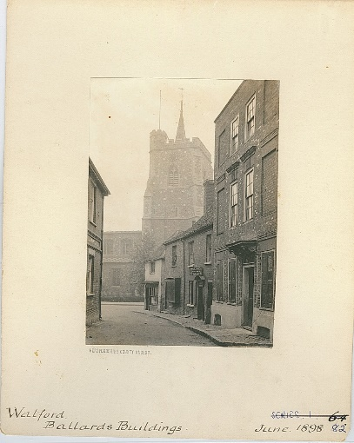
Watford history Watford in the 19th Century
A growth in industry in the 19th century also led to a growth in housing as people moved to the town for work.
Most of the streets in the town centre were laid out in the second half of the 19th century.
There were changes in the way the town was run , which included a local Board of health , an Urban district council and finally Watford Borough council from 1922

Slide 8
Watford history Watford in the 20th Century
In the 20th century, between the wars, the major employer was the railway.
After World War II printing became the most important industry.
Today the service industries are the main employers
More people have been attracted to the town, whether for work or for leisure, as the MI and the M25 made it more accessible. Our photo shows Odhams Print hall in 1954

Slide 9
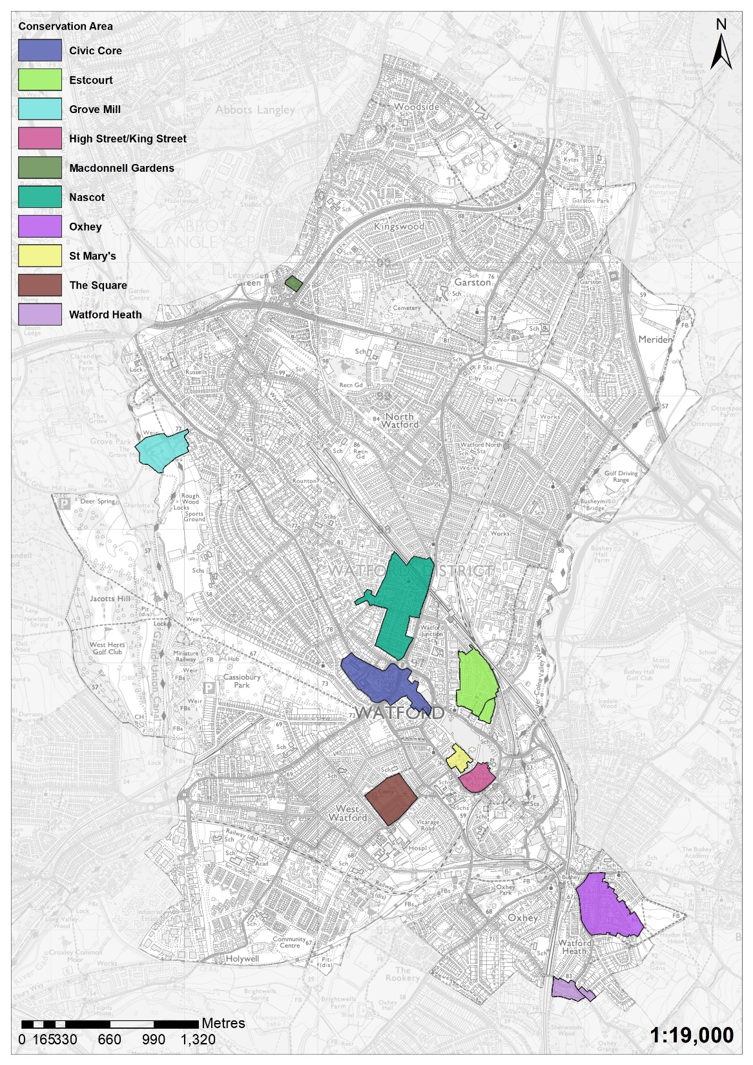
Watford Borough has 10 heritage
conservation areas.
Conservation areas exist to manage
and protect the special architectural
and historic interest of a place –
in other words,
the features that make it unique.
Every local authority in England has at least
one conservation area and there
are around 10,000 in England.

Slide 10
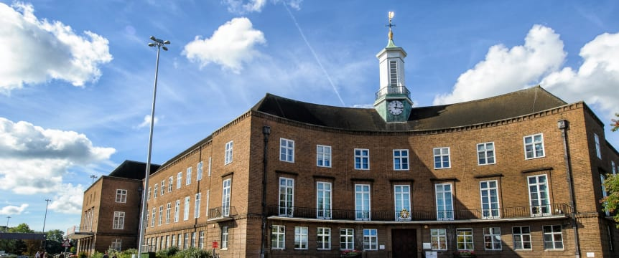
Civic core
The Civic Core Conservation area contains Watford’s main civic buildings and marks the northern limit of the town’s medieval settlement.
The conservation area follows the path of a historically important road and contains a number of nationally listed buildings. These include ‘Little Cassiobury’, a former Dower House of the Cassiobury Estate, which dates back to the late 17th century, and the Town Hall, which was opened in 1939.

Slide 11
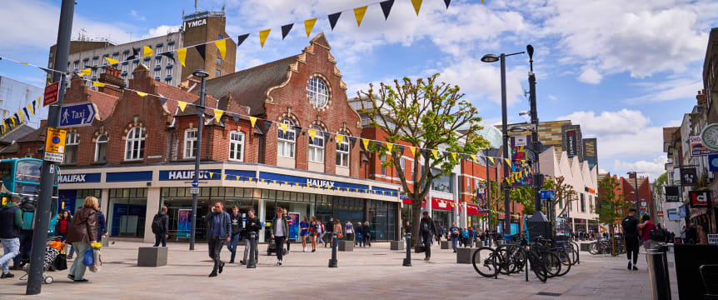
High Street and King Street
The High Street/King Street Conservation Area includes the only surviving concentration of 16th and 17th century buildings in the town, at the Watford High Street Station end of the High Street.
Many of these were re-fronted in the 18th and 19th centuries, hiding their ancient origins. The area also includes an area of the 19th and 20th century expansion of the town, with buildings including a former police station, a cinema and a Georgian mansion all fronting on to King Street.

Slide 12
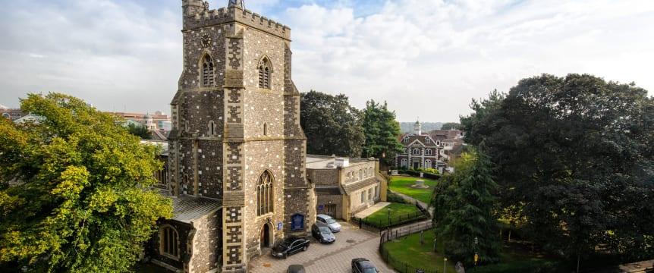
St Marys
St Mary’s Conservation Area marks the historic centre of Watford. It contains St Mary’s Church, Watford’s oldest standing building, and other notable buildings such as the Elizabeth Fuller Free School and the Bedford Almshouses. Local welfare and educational provision in the town originated from this area and it continues to be a focal point of the town.
The enclosed nature of the conservation area, with its trees and ancient buildings, contrasts the open bustle of the High Street

Slide 13
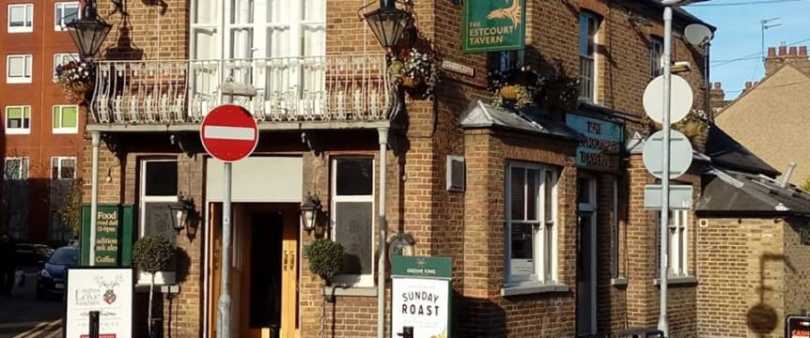
Estcourt Conservation Area
Estcourt was originally farmland, and was developed following the opening of the railway station at Watford Junction in 1858.
Estcourt stands out from other Victorian areas of the town because of the mix of uses it had within the area; terraced housing interspersed with small workshops and yards, as well as a wide variety of public houses, independent shops and public buildings.

Slide 14
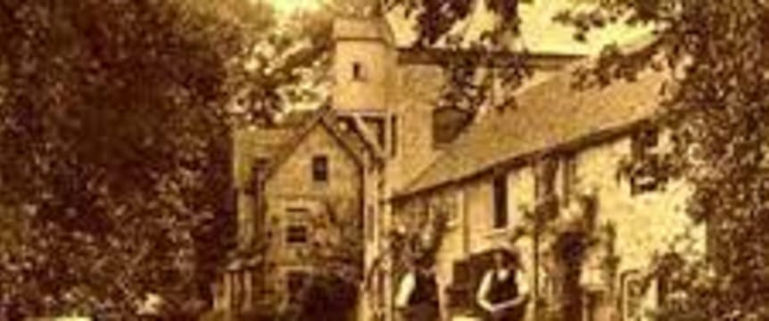
The Grove Mill Lane Conservation Area
The Grove Mill Lane Conservation Area crosses the River Gade and the Grand Union Canal, and it has a rural quality that is unusual in Watford.
Many of the buildings in the area have historical links with the Grove Estate, including the former mill. A mill is believed to have been in the area since the Domesday Book was compiled in the 11th century.
A group of buildings also surround the late 17th century former Heath Farm House, which ceased to be used for agriculture in the 1970s.

Slide 15
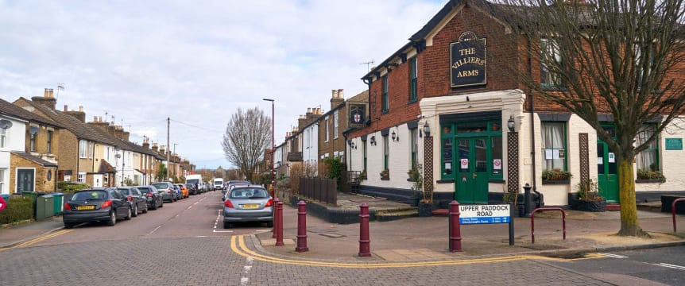
Oxhey Conservation Area
Oxhey Conservation Area is one of Watford’s oldest residential areas. It built up quickly following the opening of Bushey railway station in 1841.
The area’s separation from Watford by Bushey Arches, and the open fields to the south, give the area an almost village-like character. This is reinforced by the variety of terraced, semi-detached and detached housing, dotted with various shops and pubs.

Slide 16
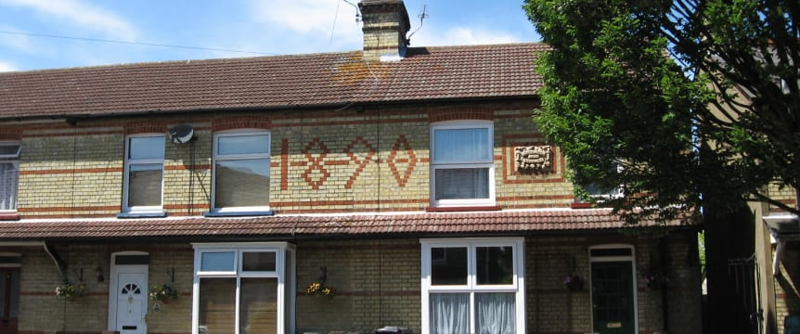
The Square Conservation Area
The Square Conservation Area is a great example of Watford’s Victorian era expansion. The original layout remains unchanged, and the buildings in the four residential streets (Aynho, Oxford, Banbury and Souldern Streets) have retained much of their original architectural detailing.
The houses were developed over a short period of time by the local building firm of Clifford and Gough through the 1890s. The largest feature in the area is Watford Cemetery, which opened in 1858.

Slide 17
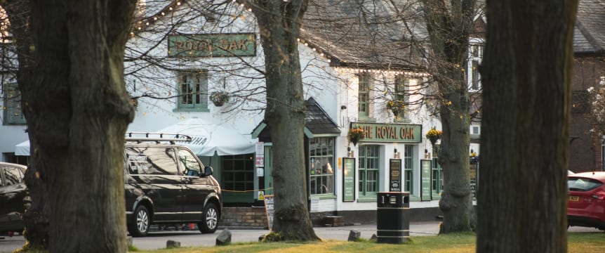
Watford Heath Conservation Area
Watford Heath is one of Watford Borough’s most characterful areas, with its village green feel and harmonious buildings.
Many of the houses were constructed during the ‘Arts and Crafts’ and ‘Domestic Revival’ periods (1900-1930) as part of the Oxhey Grange Estate, but sold to private individuals in the 1930s. The area also contains a number of buildings from the eighteenth to nineteenth centuries, which adds to the local character.
.

Slide 18
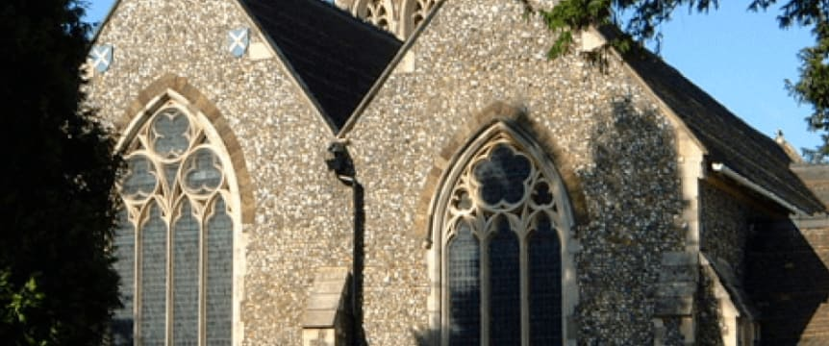
Nascot Conservation Area
The core of the Nascot Conservation Area was the first large site in Watford to be developed away from the historic High Street. It includes the town’s first railway station, which dates from 1837 and was the first significant building to be erected there.
Much of the area was formerly part of Nascot Farm, and was built on after being auctioned in the 1860s. The area contains some of the best examples of Victorian architecture in Watford, including the Church of St Andrew and several large villas.

Slide 19
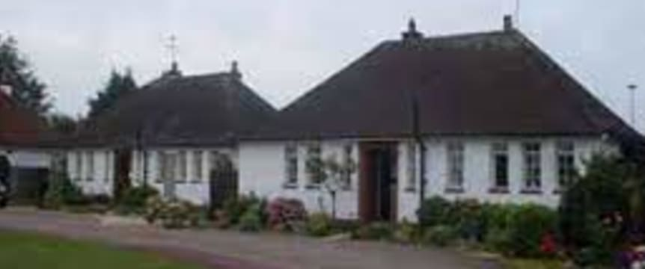
MacDonnell Gardens
The Macdonnell Gardens development was built in the 1930s for occupation by disabled ex-military officers who had fought in World War I. The houses were designed by the local architect Henry Colbeck, who also designed and lived in Cheslyn House.
The bungalows in MacDonnell Gardens still provide homes for ex-military officers with disabilities to this day, and the area’s links with the armed forces are celebrated with commemorative plaques and flags.

Slide 20
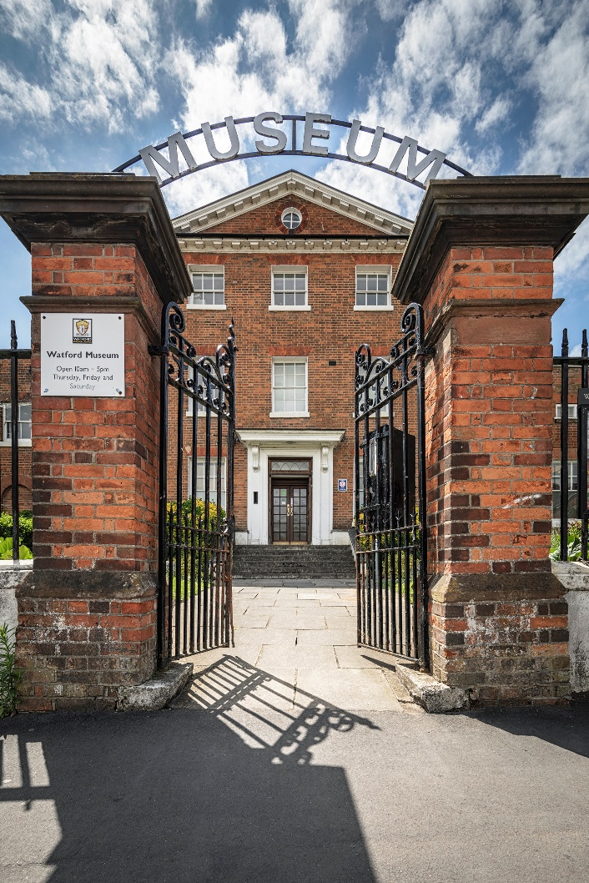
Thank You!
Watford Museum
Open Thursday to Saturday
10am – 5pm
Admission Free
www.watfordmuseum.org.uk

