Slide 1
A Short History of Cassiobury

Slide 2
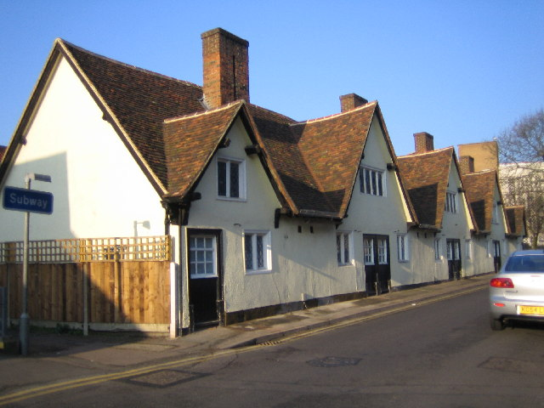

Slide 3
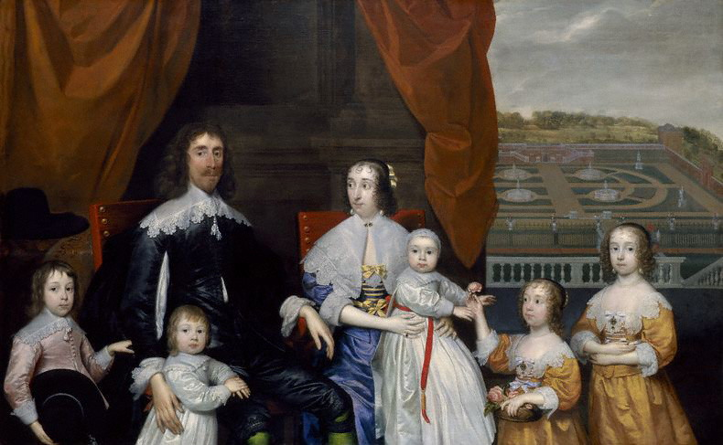

Slide 4
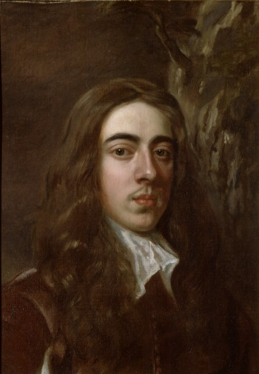
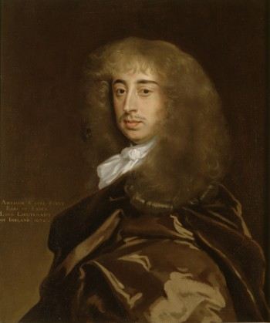
1st Earl of Essex Arthur Capel 1631 – 1683
Held prisoner at the age of 15 in rebellions against Parliament.
Charles II restored to throne in 1660, made Arthur Earl of Essex in 1661.
Set about rebuilding Cassiobury House.
A skilled politician, but fell from royal grace and was eventually implicated in the Rye House Plot against Charles II.
Died in suspicious circumstances in Tower in 1683 and ghost said to ride on horseback

Slide 5
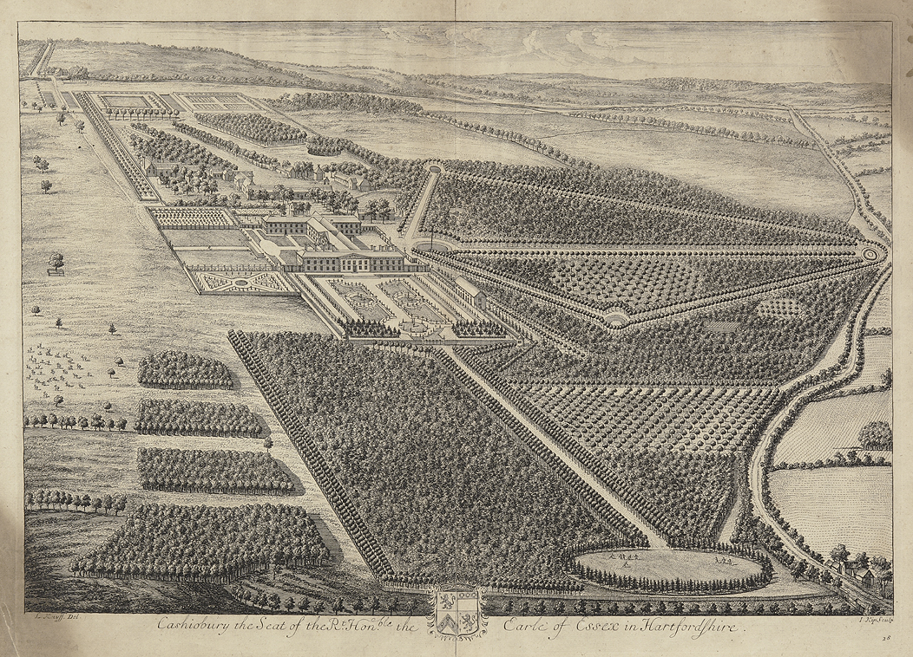
Print by Johannes Kip after an engraving by Leonard Knyff in 1707.

Slide 6
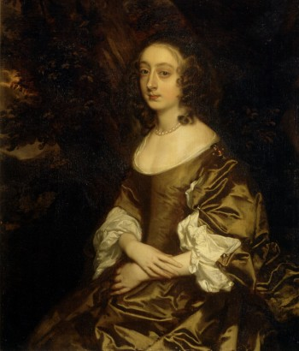
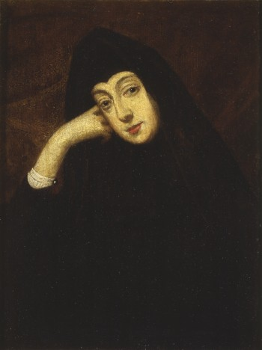
Lady Elizabeth Percy (1636 – 1717)
5th daughter of Algernon Percy, 10th Earl of Northumberland.
She married Arthur in 1653.
Described by John Evelyn in 1680 as “a wise, yet somewhat melancholy woman, setting her heart too much on the little lady her daughter, of whom she is over fond”.
Outlived her husband by 30 years

Slide 7
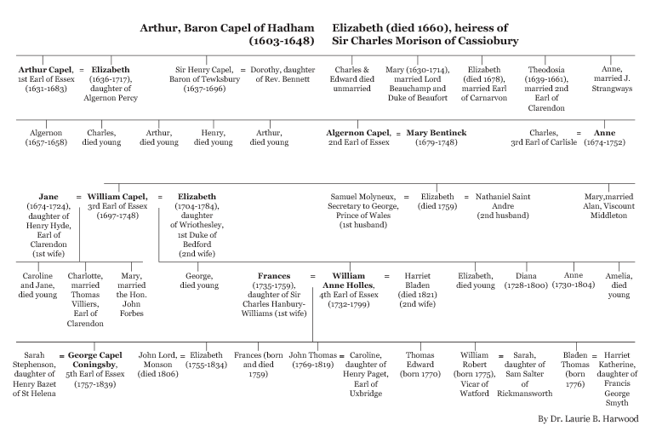

Slide 8
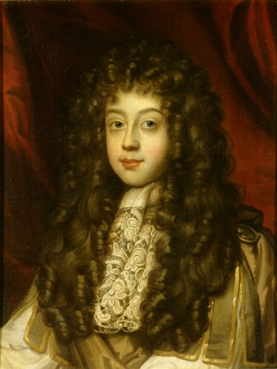
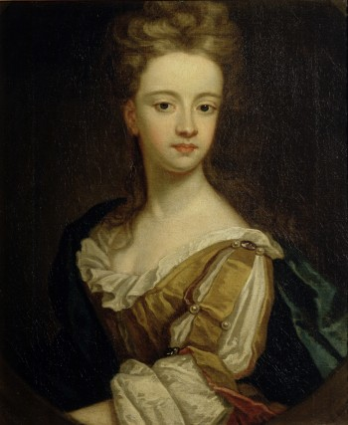
Algeron Capel, 2nd Earl of Essex (1670 – 1710) and his wife Lady Mary Bentinck (1679 – 1726)
Algeron succeeded to Earldom when only 13 in 1683. He distinguished himself with Royalty for his endeavours on the battlefield and was a member of the celebrated Kit-Kat Club. Lady Mary was “one of the toasts of honour and re-nown at the famous Kit-Kat Club". According to Lord Effingham

Slide 9
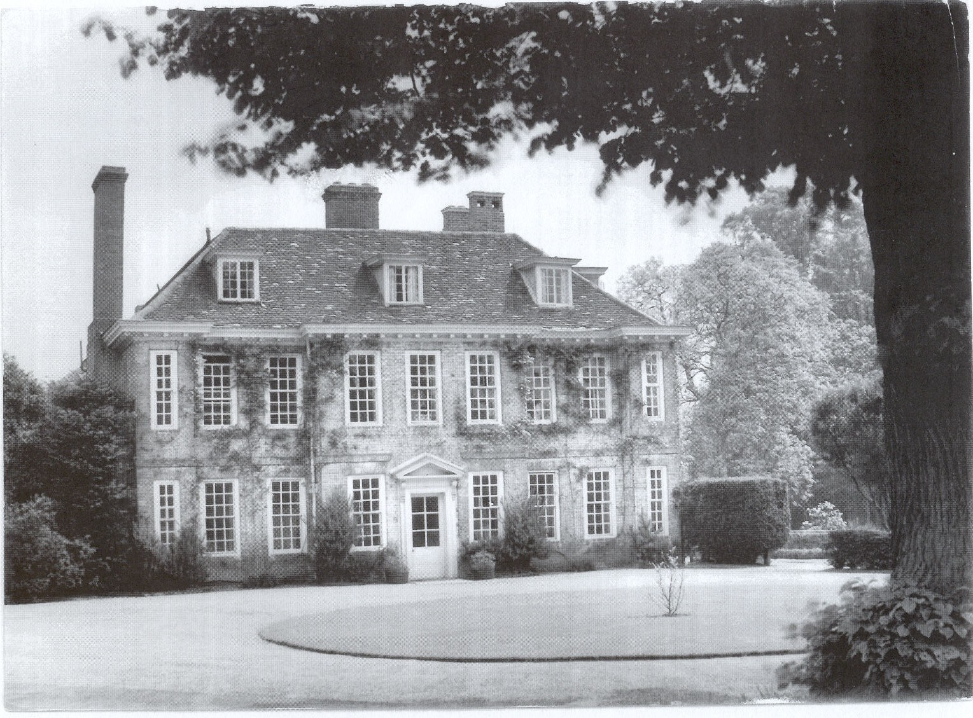

Slide 10
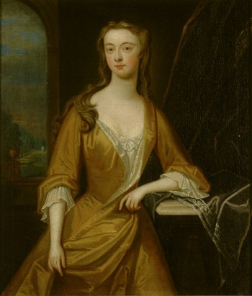
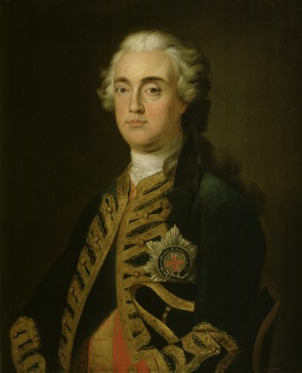
William, 3rd Earl of Essex (1697 – 1748) and Lady Jane Hyde (1694 – 1724)
Succeeded to title in 1709, but did not take his seat in Lords till adulthood. In service to royal family had roles including Gentleman of the Bedchamber to the Prince of Wales and Lord Lieutenant of Herts .He had 10 children in his two marriages. Lady Jane was daughter of 4th Earl of Clarendon. She was Lady of the Bedchamber to Princess of Wales and admired for beauty and good nature. She died from fever aged 30 in Paris

Slide 11
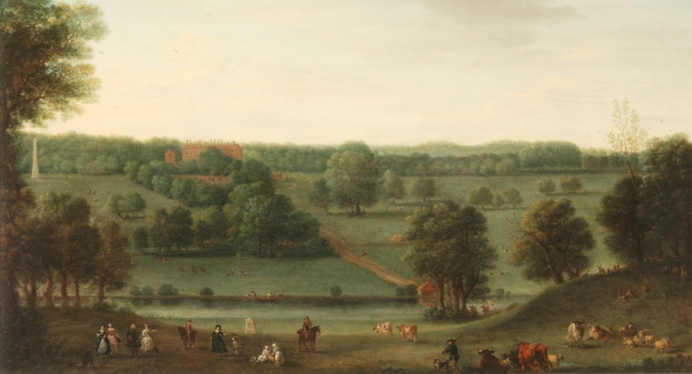
A View of Cassiobury Park by John Wootton, c1748
Depicts Earl on horseback, family, friends & servants.
Points of interest - House, obelisk, River Gade, St Mary’s Church, signpost reading “19 miles to London". Hung in entrance hall to Cassiobury.
Purchased at auction at Sotheby’s New York for $120,000

Slide 12
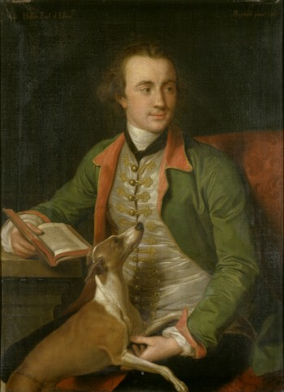
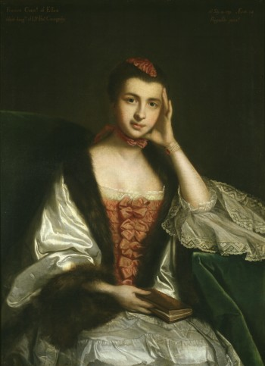
William Anne Holles, 4th Earl of Essex (1732 – 99) and France s Hanbury Williams (1735 – 59)
William born in Turin. Lord Lieutenant of Herts like his father.
He was married twice

Slide 13
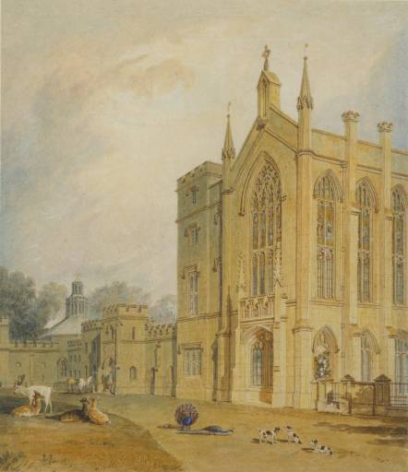
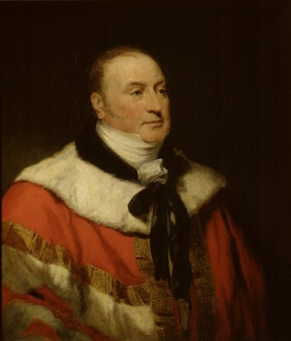
George Capel Coningsby, 5th Earl (1757 – 1839)
On becoming earl, George employed James Wyatt to rebuild house. He was a great patron of the arts, inviting Turner to visit. Between 1804-7 Turner painted 4 watercolours of house. This is View of the south west front of Cassiobury House, J.M.W. Turner, 1804 -7
His first marriage was unhappy. In 1838 his first estranged wife Sarah died. The same year he married at the age of 82 the actress and singer Kitty Stephens who was 44.

Slide 14
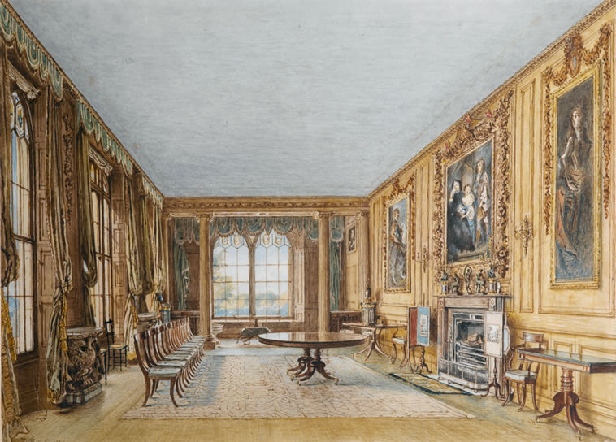
Winter Dining Room, 1831 by William Henry Hunt

Slide 15
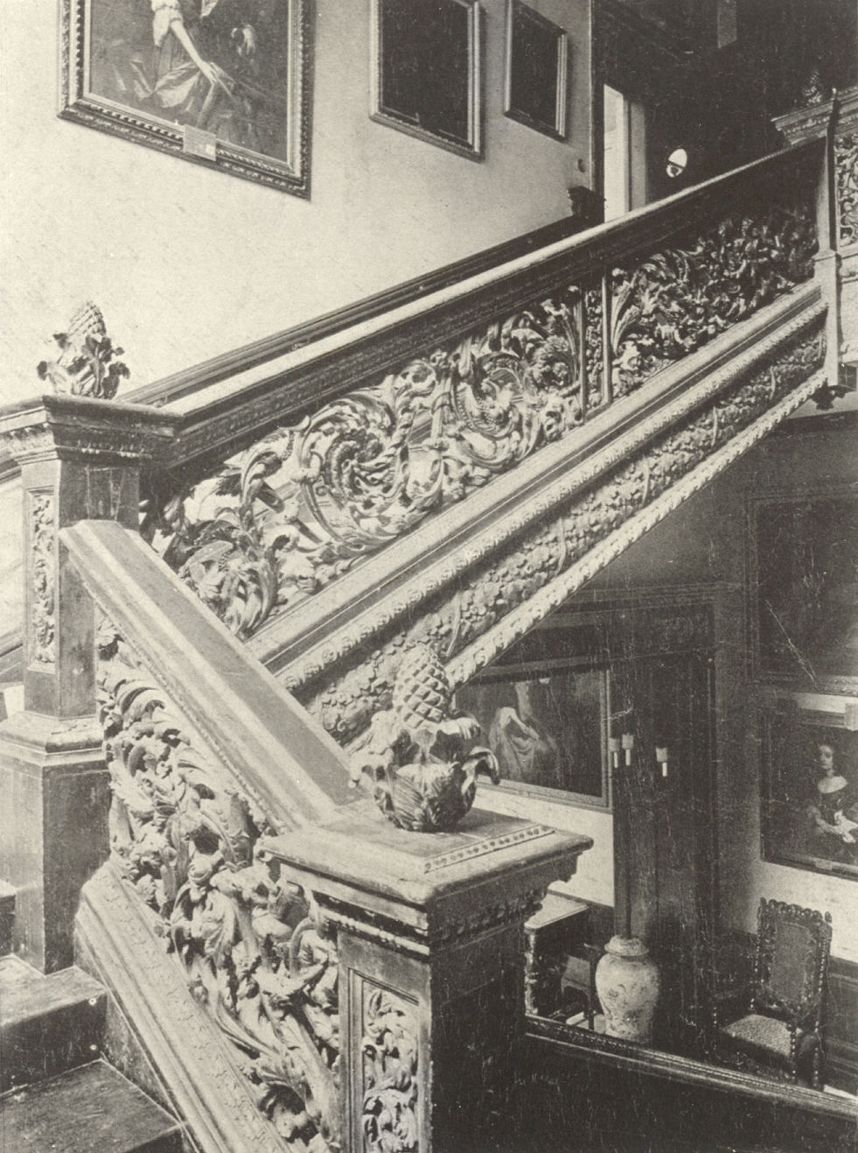
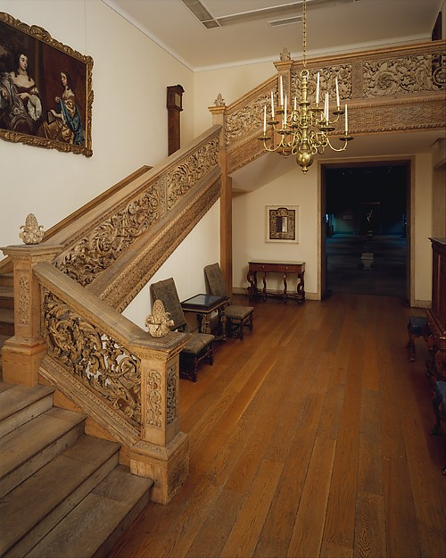
Main staircase attributed to Grinling Gibbons – in Metropolitan museum
of art in New York
Famous woodcarver and sculptor, born in Rotterdam. Came to England before 1672 & became Master Carver in Wood to the Crown.
Cassiobury was his 1st commission, working between 1673 & 1680.

Slide 16
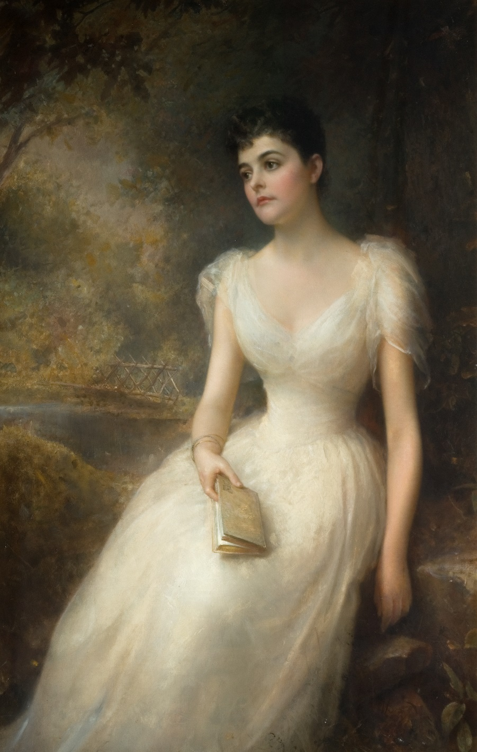
Adele, second wife of the 7th Earl of Essex by Edward Hughes, 1893
This shows Adele in front of footbridge across the River Gade.
Her father, millionaire Beach Grant, was from New York,
but Adele had spent most of her childhood in Europe.
It was a time when many wealthy American women were marrying into peerage.
Her arrival in Watford was greeted with great ceremony. Her carriage was drawn by men through the town & an arch was erected at the Essex Hotel.
During the early years of her marriage she enjoyed entertaining on a lavish scale but also riding & gardening, plus charitable works in Watford area.

Slide 17
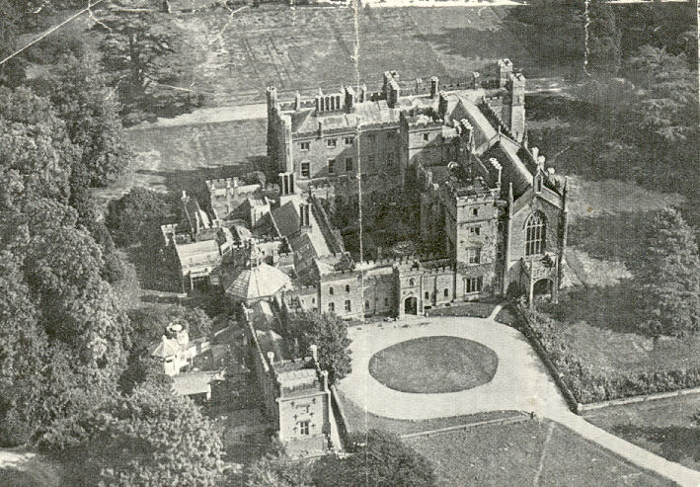

Slide 18
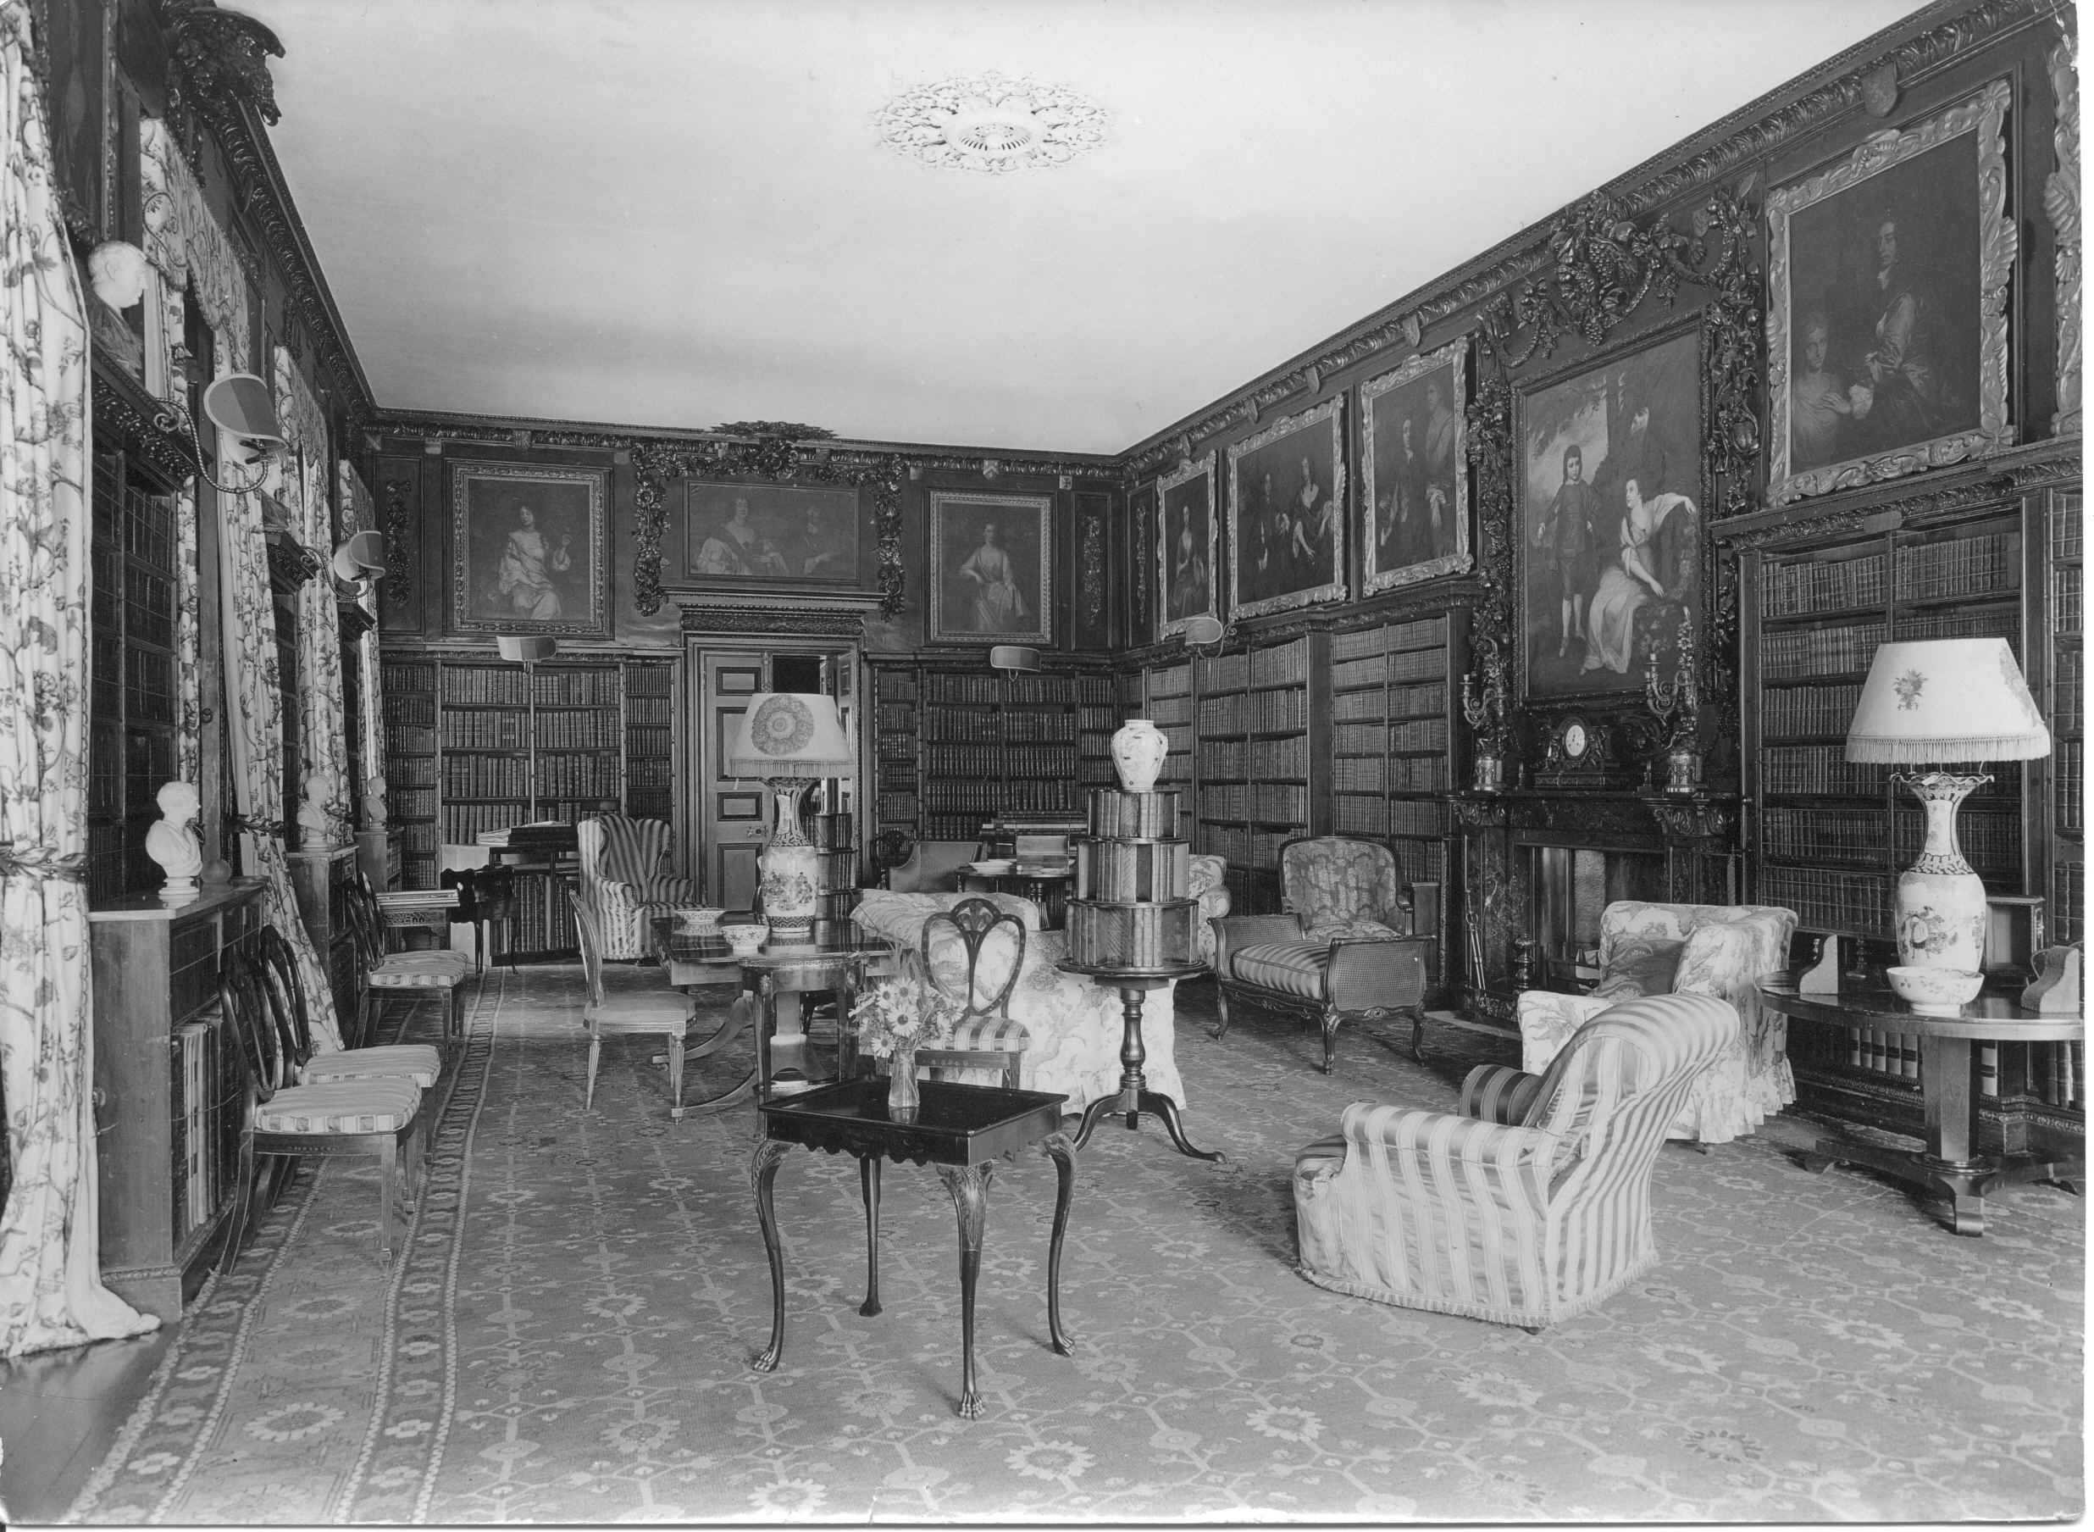

Slide 19
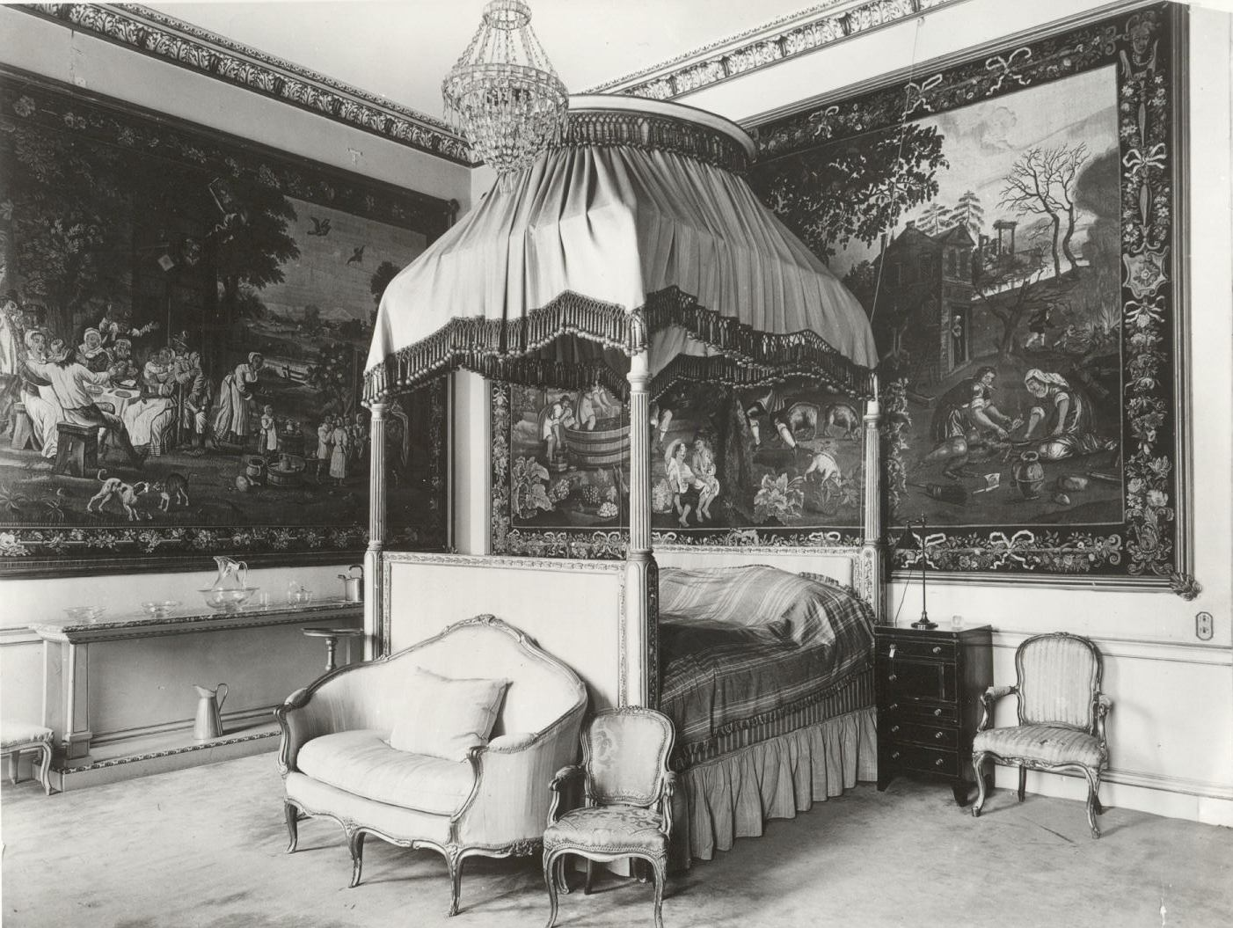

Slide 20
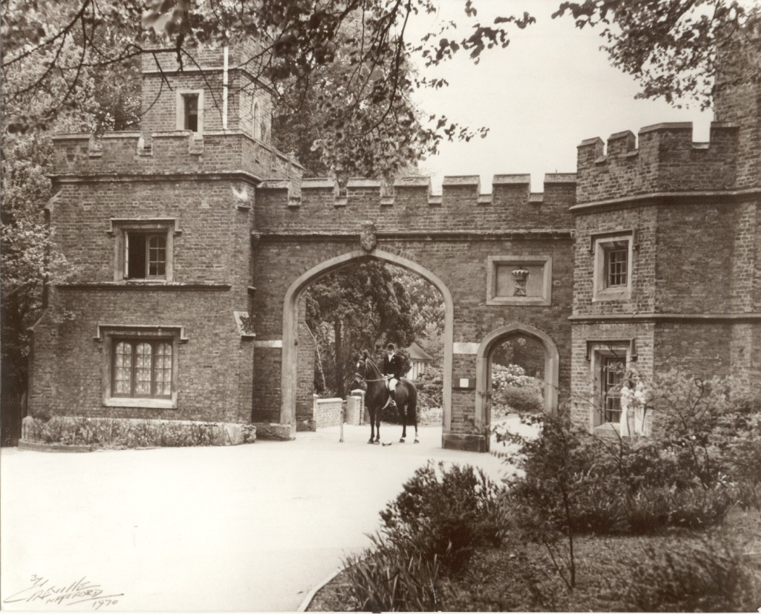
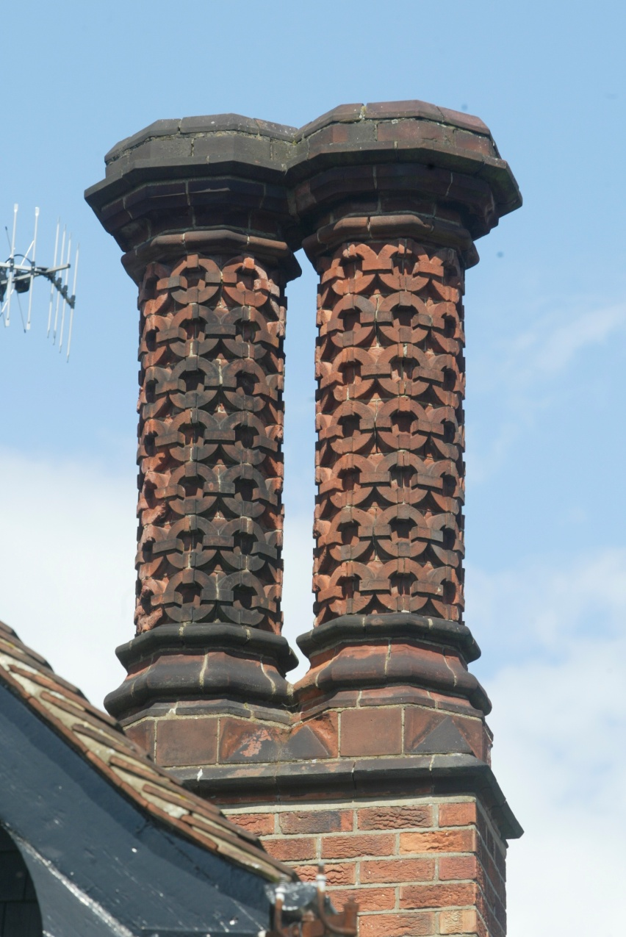

Slide 21
The end of Cassiobury house
1908 the family began to sell off parts of the park & put house up for rent. In it’s heyday the house had been a venue for lavish parties, but these became fewer and fewer
The contents In of house was sold under direction of the 8th Earl and the Dowager Lady of Essex in 1922.
The house was sold and after finding that no individual or corporation would take on the house, it was demolished in 1927.
Part of grounds bought by council for a public part against the general wishes of Watford people.
Fine art & antiques from house at museum and round the world. Building materials were used in Yates and the Cassiobury estate

Slide 22
