Slide 1
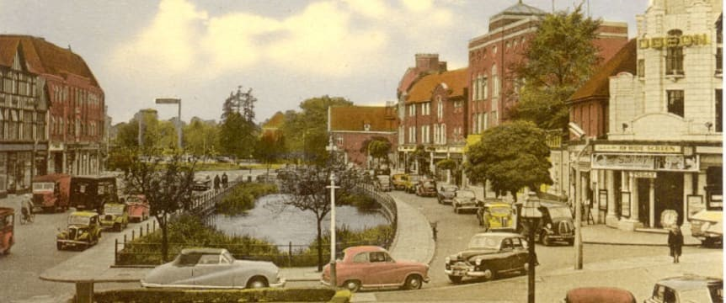
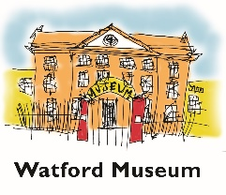
Conservation areas in Watford
Watford Borough has 10 heritage conservation areas These were designated to protect areas of special architectural or historic interest.
This year there has been a review of a document called the Conservation Areas management plan, which was created in 2013. This plan set out Watford Borough Council’s approach for preserving and enhancing conservation areas.
Much useful information has been gathered and published during this process. It has been collated in the related presentation to support learning about the local area

Slide 2
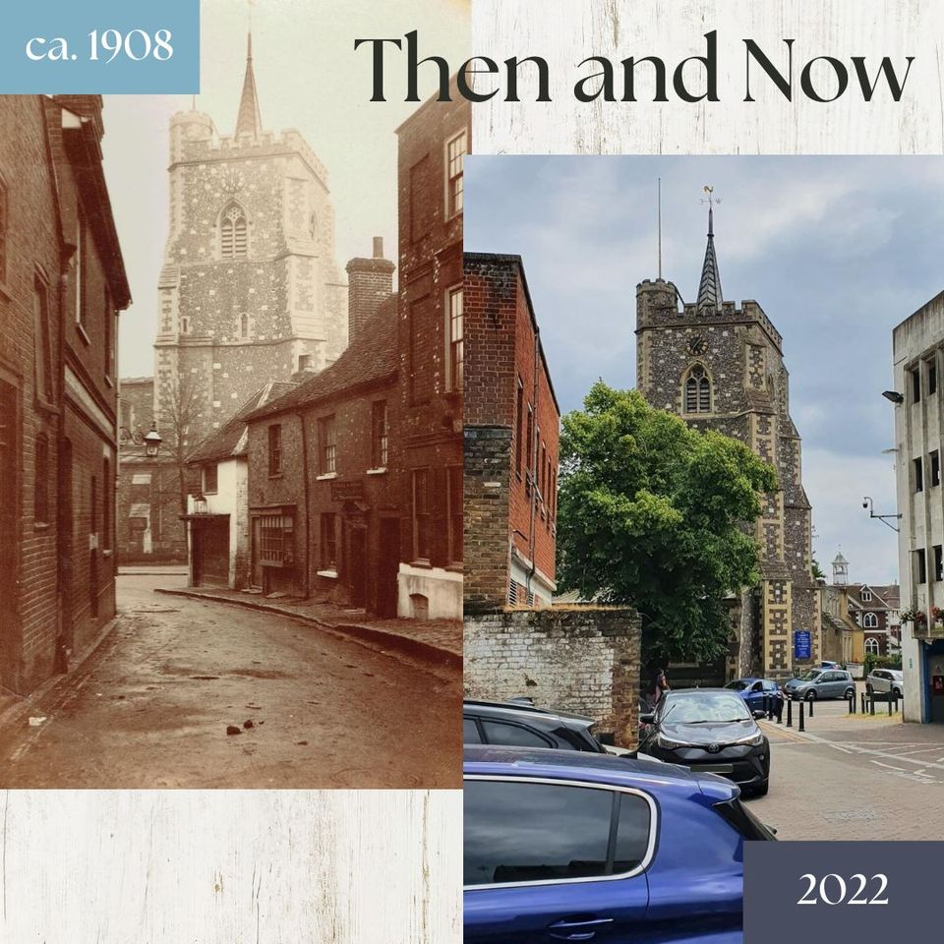

Slide 3
New Street is actually one of the oldest streets in Watford. It is in St. Marys Conservation Area
It is thought to be the street mentioned in the Manor of Cassiobury Court Rolls as early as 1436!
Just off New Street was a row of late 17th century cottages known for a time as Dyson’s Yard or Buildings and then sometime between 1838 and 1849 as Ballard’s buildings.
William James Ballard (1799-1867) bought the property during this time, probably around 1846. Ballards Buildings became one of the most overcrowded slums in the town.
In 1851, it was recorded that there was 226 people living in 39 out of 42 buildings.
In 1853, the Board of Health described it as having 300-400 occupants.
The buildings were demolished in 1926.

Slide 4
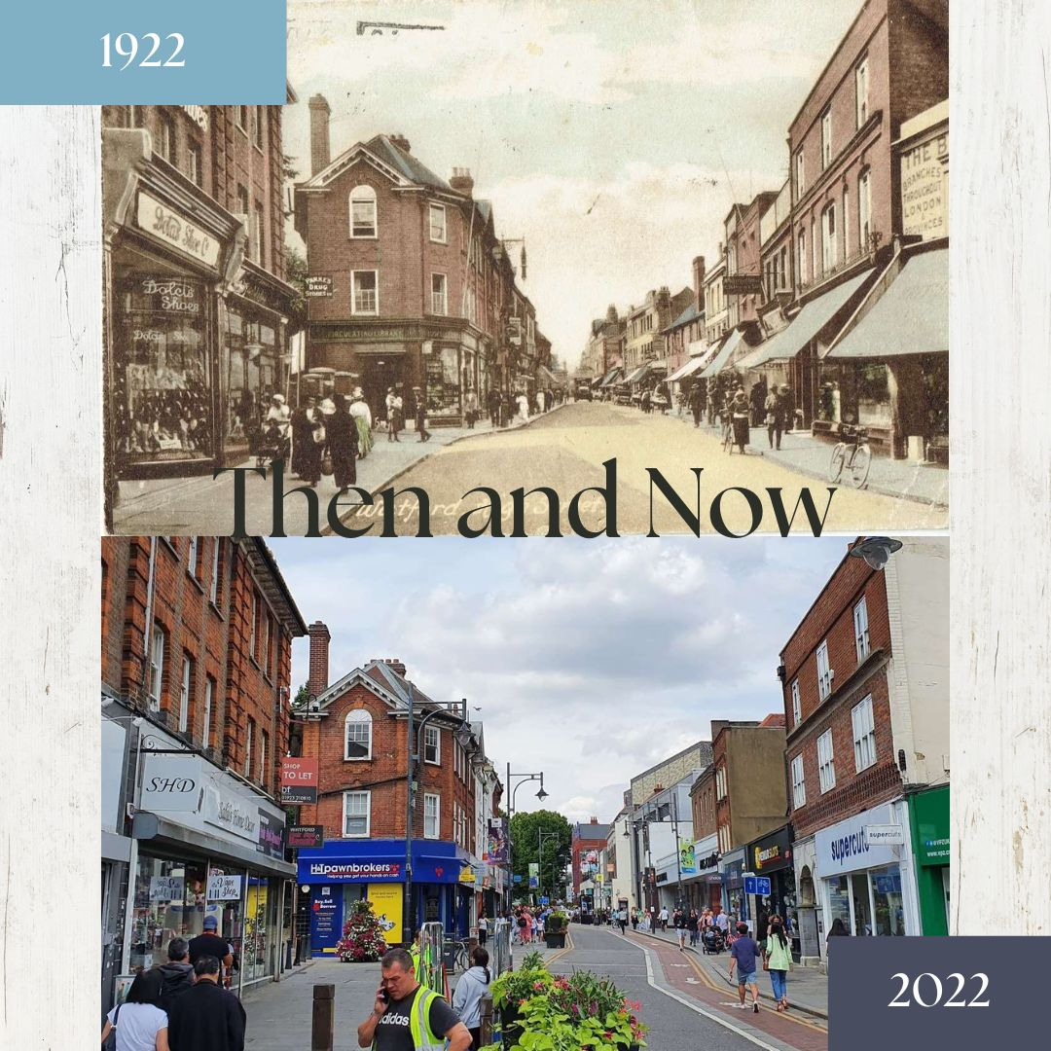

Slide 5
The buildings on the left of the street are all part of St. Mary’s Conservation area
This was established in 1975 and one of the oldest conservation areas in Watford.
Most of the commercial shops in the postcard image were built at the beginning of the 1900s-1920s replacing earlier much older buildings. Their building was in response to the population of Watford growing.
We can see there has been considerable change on the east side of the High Street, although the large brick building near the right of the photo (103-105 High Street) built in 1895 has survived.

Slide 6
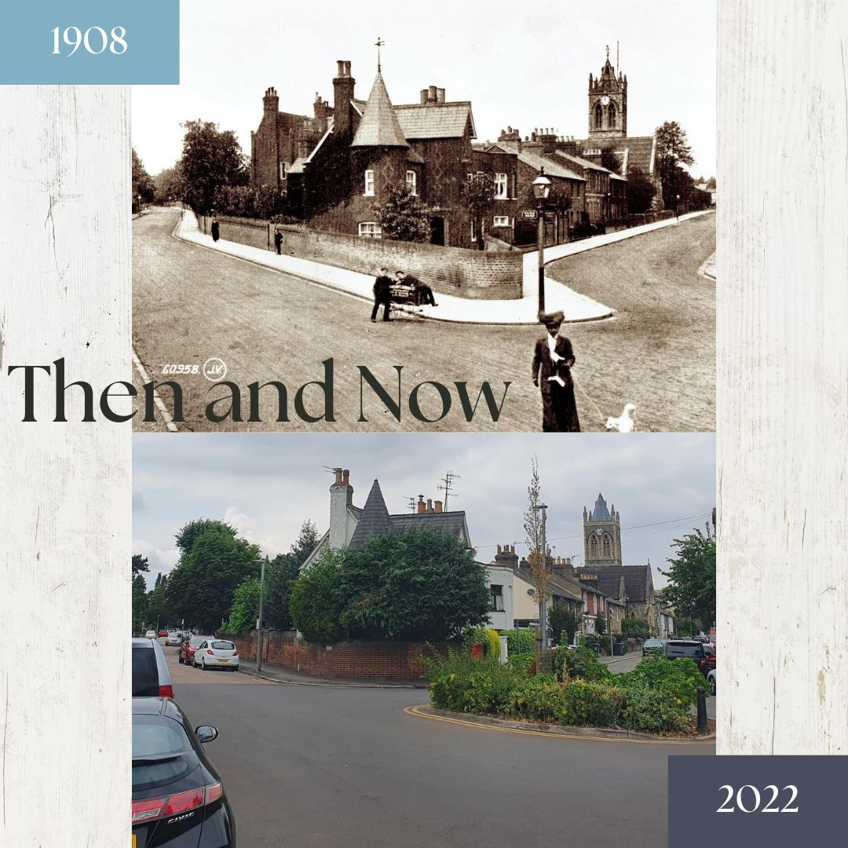

Slide 7
These photos are from Nascot Conservation Area
This is the corner of Park Road junction with Church Road, with St. Andrew’s church in background.
In 1837, Watford’s first railway station was built just north of St. Albans Road (where it continues to stand).
This area was one of the first Watford areas to be developed in away from the High Street.
It includes some of the best examples of Victorian buildings in Watford, including St. Andrew’s Church and several large villas.
.

Slide 8
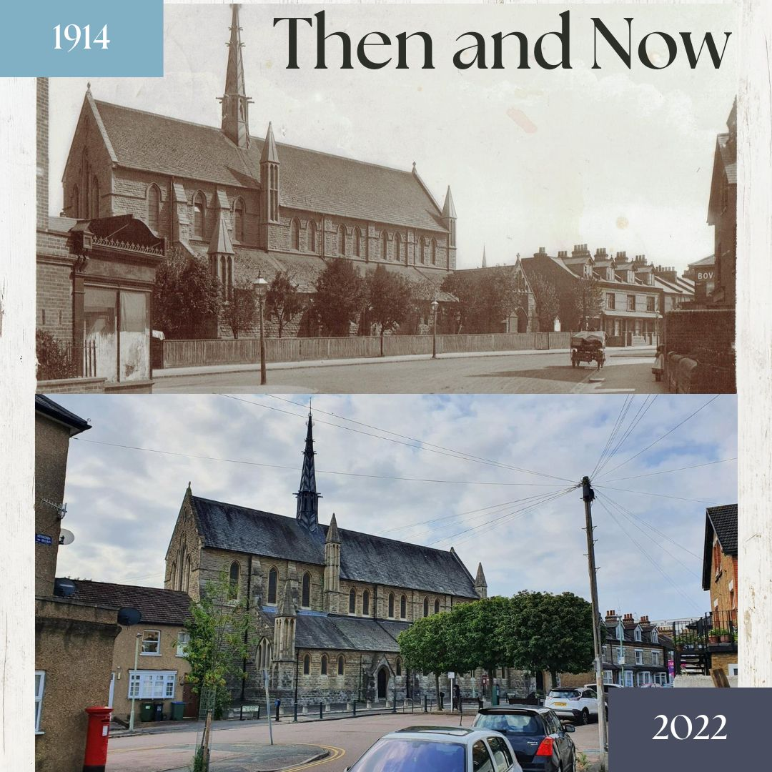

Slide 9
St. Johns Church, Sutton Road is in the Estcourt Conservation Area
As Watford grew , the Anglican community needed another church
In 1873 a temporary structure the ‘Tin Church’ was relocated to this site, and in 1891, the foundation stone for the present church was laid.
Two years and two days later, on 19th July 1893 the building was dedicated by the Lord Bishop of St. Albans.
In May 1904, St. John’s became a parish church in its own right.

Slide 10
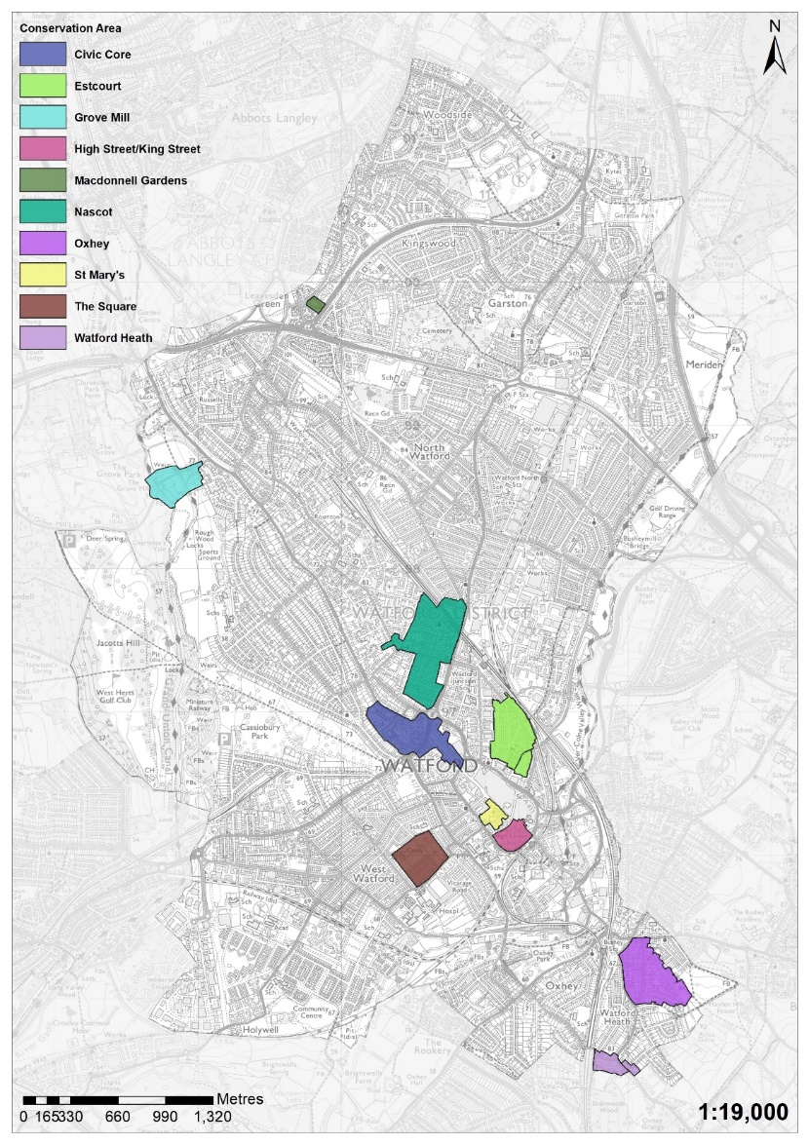
Watford Borough has 10 heritage
conservation areas.
Conservation areas exist to manage
and protect the special architectural
and historic interest of a place –
in other words,
the features that make it unique.
Every local authority in England has at least
one conservation area and there
are around 10,000 in England.
3 of the conservation areas mentioned
in the Then and Now photos are covered in
the next slides

Slide 11
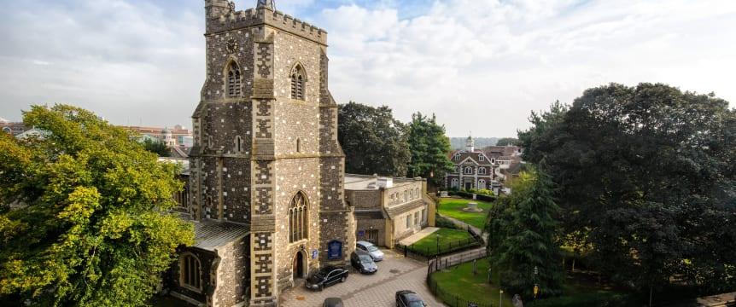
St Marys
St Mary’s Conservation Area marks the historic centre of Watford. It contains St Mary’s Church, Watford’s oldest standing building, and other notable buildings such as the Elizabeth Fuller Free School and the Bedford Almshouses. Local welfare and educational provision in the town originated from this area and it continues to be a focal point of the town.
The enclosed nature of the conservation area, with its trees and ancient buildings, contrasts the open bustle of the High Street

Slide 12
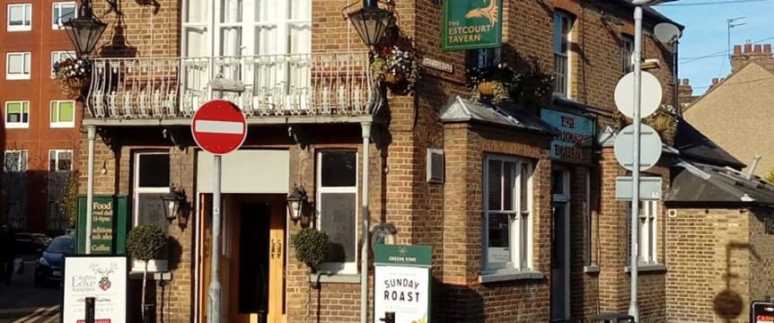
Estcourt Conservation Area
Estcourt was originally farmland, and was developed following the opening of the railway station at Watford Junction in 1858.
Estcourt stands out from other Victorian areas of the town because of the mix of uses it had within the area; terraced housing interspersed with small workshops and yards, as well as a wide variety of public houses, independent shops and public buildings.

Slide 13
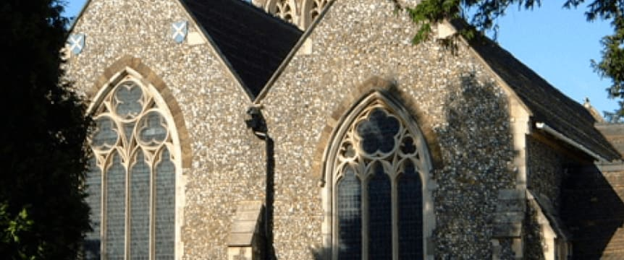
Nascot Conservation Area
The core of the Nascot Conservation Area was the first large site in Watford to be developed away from the historic High Street. It includes the town’s first railway station, which dates from 1837 and was the first significant building to be erected there.
Much of the area was formerly part of Nascot Farm, and was built on after being auctioned in the 1860s. The area contains some of the best examples of Victorian architecture in Watford, including the Church of St Andrew and several large villas.

Slide 14
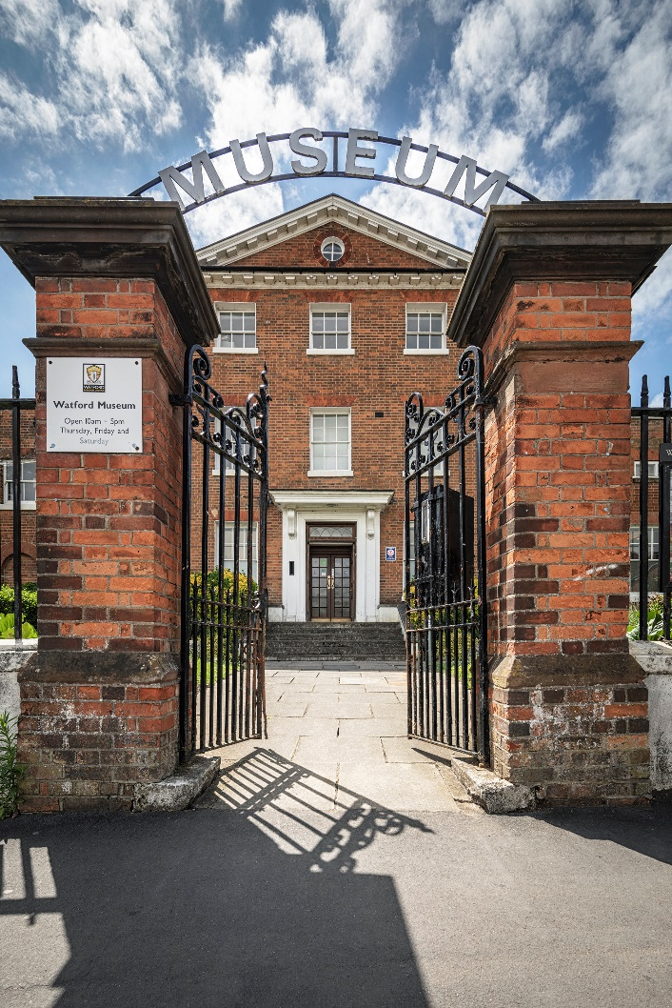
Thank You!
Watford Museum
Open Thursday to Saturday
10am – 5pm
Admission Free
www.watfordmuseum.org.uk

